Slide 1
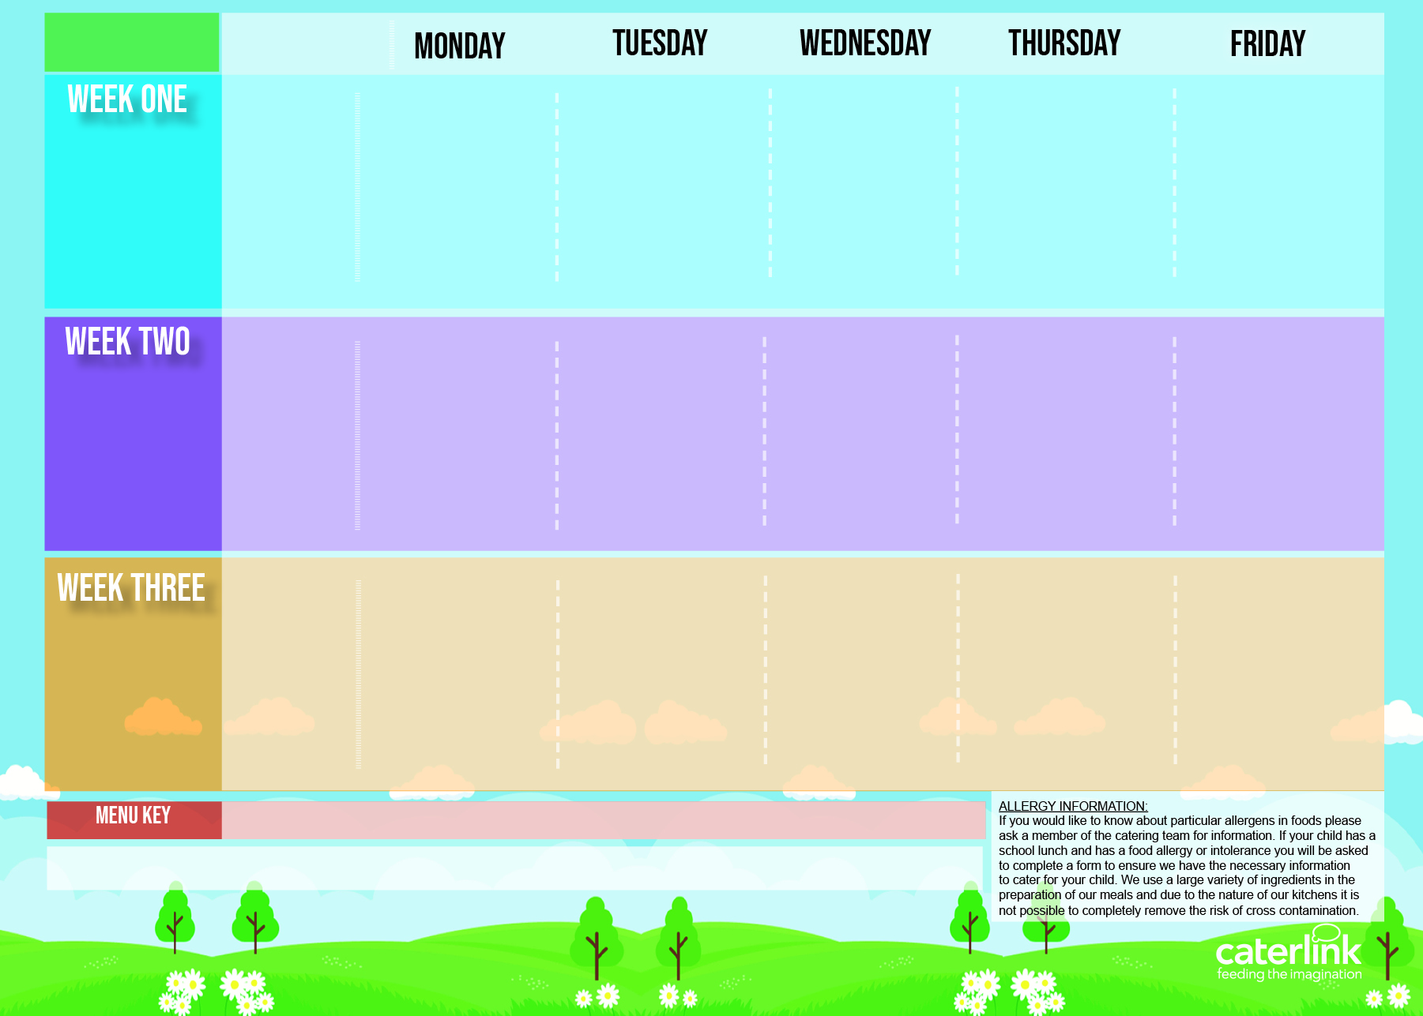
Islington St Joseph Autumn/ Winter Menu
Option one
Cheese and Tomato Pizza (V)
BBQ Chicken with New Potatoes
Minced Beef
Cottage Pie
Lentil and Roasted Vegetable Pasty with
Mash & Gravy (V)
Fishfingers with Chips
W/C
30 October
20 November
11 December
15 January
5 February
4 March
25 March
Option two
Chickpea Tagine with Cous-Cous (V)
Roasted Cauliflower Curry & 50/50 Rice(V)
Glamorgan Bean Sausages with Jacket Wedges (V)
Mac & Cheese (V)
Chicken Arrabiata Pasta
Vegetables
Cauliflower
Green Beans
Tabbouleh Power Salad
Broccoli
Sweetcorn
Carrots
Cabbage
Roasted Peppers
Green Beans
Peas
Baked Beans
Dessert
Pear Crumble with Custard
Yoghurt and
Fresh Fruit Station
Mandarin Cheesecake
Banana Loaf
Yoghurt and
Fresh Fruit Station
Golden Tortilla Stack with 50/50 Rice (V)
Mexican Bean Fajitas with 50/50 Rice (V)
Roast Chicken, Skin on Roast Potatoes and Gravy
Chicken Sausages with Mash Potato & Gravy
Butterbean Risotto (V)
Option one
W/C
6 November
27 November
18 December
22 January
19 February
11 March
Broccoli Pasta Bake (V)
Lentil Wellington with Skin on Roast Potatoes (V)
Spaghetti Bolognaise
(V)
Battered Fish & Chips
Option two
Beef Lasagne
Roasted Tomatoes
Broccoli
Sweetcorn
Courgettes
Cauliflower
Carrots
Red Cabbage
Green Beans
Peas
Baked Beans
Roasted Veg Power Salad
Vegetables
Dessert
Eves Pudding with Custard
Pear & Ginger Slice
Yoghurt and
Fresh Fruit Station
5 A Day Cake
Yoghurt and
Fresh Fruit Station
Option one
Sweet & Sour Butterbeans with 50/50 Rice (V)
Spicy Bean Burger with Jacket Wedges (V)
Roast Turkey, Mashed Potatoes and Gravy
Roasted Vegetable Pizza
Salmon Fish Fingers
and Chips
W/C
13 November
4 December
8 January
29 January
26 February
18 March
Option two
Chickpea & Vegetable
Hot Pot with Mash Potato (V)
Chicken Tagine
with Cous-Cous
Chilli con Carne
with 50/50 Rice
Mexican Enchiladas
and Rice (V)
Jollof Rice, Quorn & Beans (V)
Vegetables
Roasted Peppers
Green Beans
Sweetcorn
Peas
Leeks
Carrots
Broccoli
Cauliflower
Sweet Potato Power Salad
Peas
Baked Beans
Dessert
Yoghurt and
Fresh Fruit Station
Apple & Raisin Strudel
with Custard
Yoghurt and
Fresh Fruit Station
Peach Upside Down Cake
with Custard
Rice Pudding with Fruit Compote
Added Plant Power
Wholemeal
Vegan & Planet Friendly
(V) Vegetarian
Available Daily:
Freshly cooked jacket potatoes with a choice of fillings (where advertised) - Bread freshly baked on site daily- Daily salad selection
Fresh Fruit and Yoghurt is available daily

Slide 2
Islington Autumn/ Winter Menu
Option one
Cheese and Tomato Pizza V231
Roasted Cauliflower Curry V148 & 50/50 Rice SD84
Minced Beef
Cottage Pie B38
Vegetable Pasty V35 with
Mash SD1 & Gravy SD118
BBQ Chicken QB14 and Chips SD5
W/C
30 October
20 November
11 December
15 January
5 February
4 March
25 March
Option two
Vegetable Tagine V140 with Cous-Cous SD119
Fishfingers F6 with New Potatoes SD2
Glamorgan Bean Sausages V125 with Jacket Wedges SD6
Chicken Arrabiata Pasta C41 SD11
Mac & Cheese V11
Vegetables
Cauliflower SD27
Green Beans SD24
Tabbouleh SB25
Broccoli SD20
Sweetcorn SD19
Carrots SD28
Cabbage SD35
Roasted Peppers SD26
Green Beans SD24
Peas SD18
Baked Beans SD22
Dessert
Pear Crumble D236 with Custard D2
Yoghurt and
Fresh Fruit Station
Mandarin Cheesecake D204
Banana Loaf D173
Yoghurt and
Fresh Fruit Station
Golden Tortilla Stack with 50/50 Rice #V105 #SD84
Vegetable & Bean Fajitas V211 with 50/50 Rice SD84
Roast Chicken C5, Skin on Roast Potatoes SD82 and Gravy SD118
Chicken Sausages C6 with Mash Potato SD1 & Gravy SD118
Butterbean Risotto #V133
Option one
W/C
6 November
27 November
18 December
22 January
19 February
11 March
Beef Lasagne B39
Vegetable Wellington V232 with Skin on Roast Potatoes SD82 and Gravy SD118
Vegetable Spaghetti SD8 Bolognaise V233
Battered Fish F3 & Chips SD5
Option two
Broccoli Pasta Bake V51
Roasted Tomatoes SD34
Broccoli SD20
Sweetcorn SD19
Courgettes SD29
Red Cabbage SD23
Green Beans SD24
Peas SD18
Baked Beans SD22
Roasted Veg & Lentil Power Salad SB20
Vegetables
Cauliflower SD27
Carrots SD28
Dessert
Eves Pudding D189
with Custard D2
Pear & Ginger Slice D9
Yoghurt and
Fresh Fruit Station
5 A Day Cake D203
Yoghurt and
Fresh Fruit Station
Sweet & Sour Butterbeans V69 with 50/50 Rice SD84
Spicy Bean Burger V33 in a Bun SD17 with Jacket Wedges SD6
Roast Turkey T1 Mashed Potatoes SD1 and Gravy SD118
Roasted Vegetable Pizza
V243
Option one
Salmon Fish Fingers F1 and Chips SD5
W/C
13 November
4 December
8 January
29 January
26 February
18 March
Option two
Chickpea & Vegetable Hotpot V41 with Mashed Potato #SD1
Chicken Tagine C60
with Cous-Cous SD119
Jollof Rice, Quorn & Beans V106
Chilli con Carne B49
with 50/50 Rice SD84
Vegetable Enchiladas
V20 and Rice SD84
Vegetables
Roasted Peppers SD26
Green Beans SD24
Sweetcorn SD19
Peas SD18
Leeks
Carrots SD28
Broccoli SD20
Cauliflower SD27
Sweet Potato Power Salad SB8
Peas SD18
Baked Beans SD22
Dessert
Yoghurt and
Fresh Fruit Station
Apple & Raisin Strudel D59
with Custard D2
Yoghurt and
Fresh Fruit Station
Peach Upside Down Cake D176
with Custard D2
Rice Pudding with Fruit Compote D31
Added Plant Power
Wholemeal
Vegan
Available Daily:
Freshly cooked jacket potatoes with a choice of fillings (where advertised) - Bread freshly baked on site daily- Daily salad selection
Fresh Fruit and Yoghurt is available daily

