Slide 1
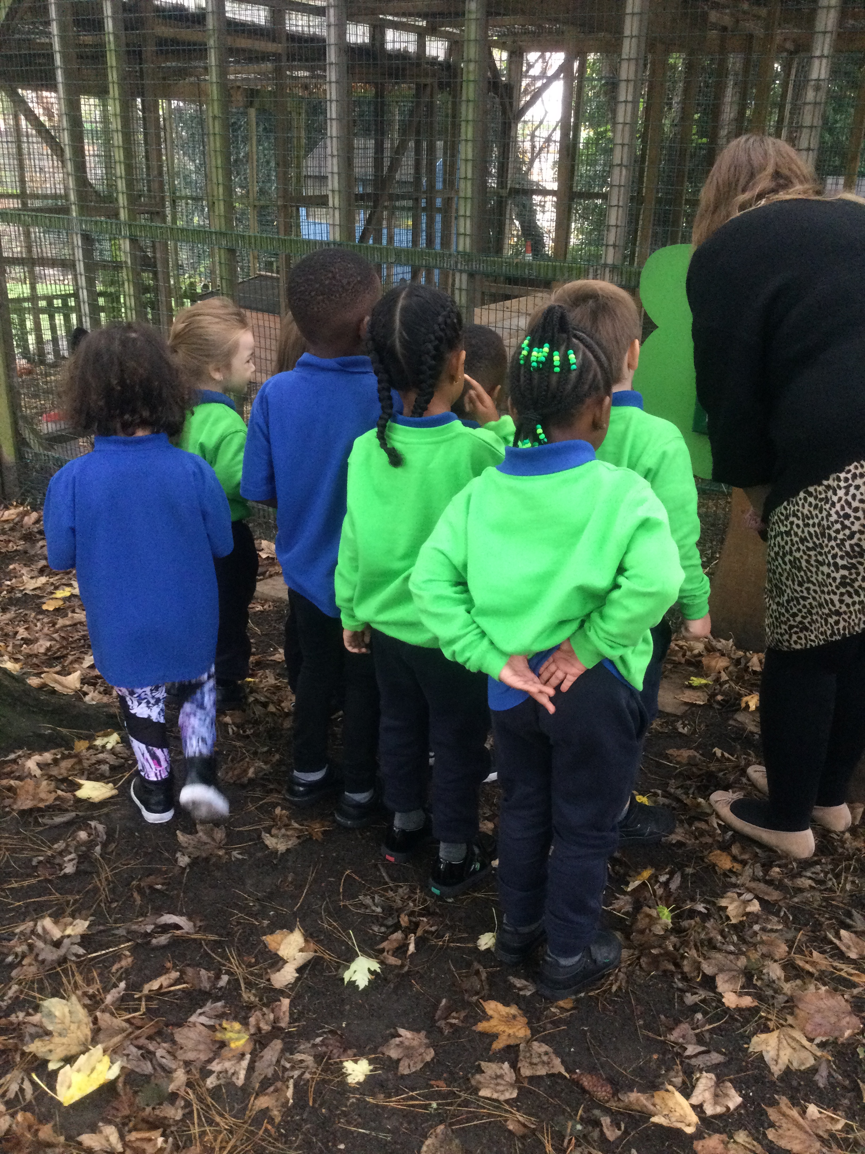
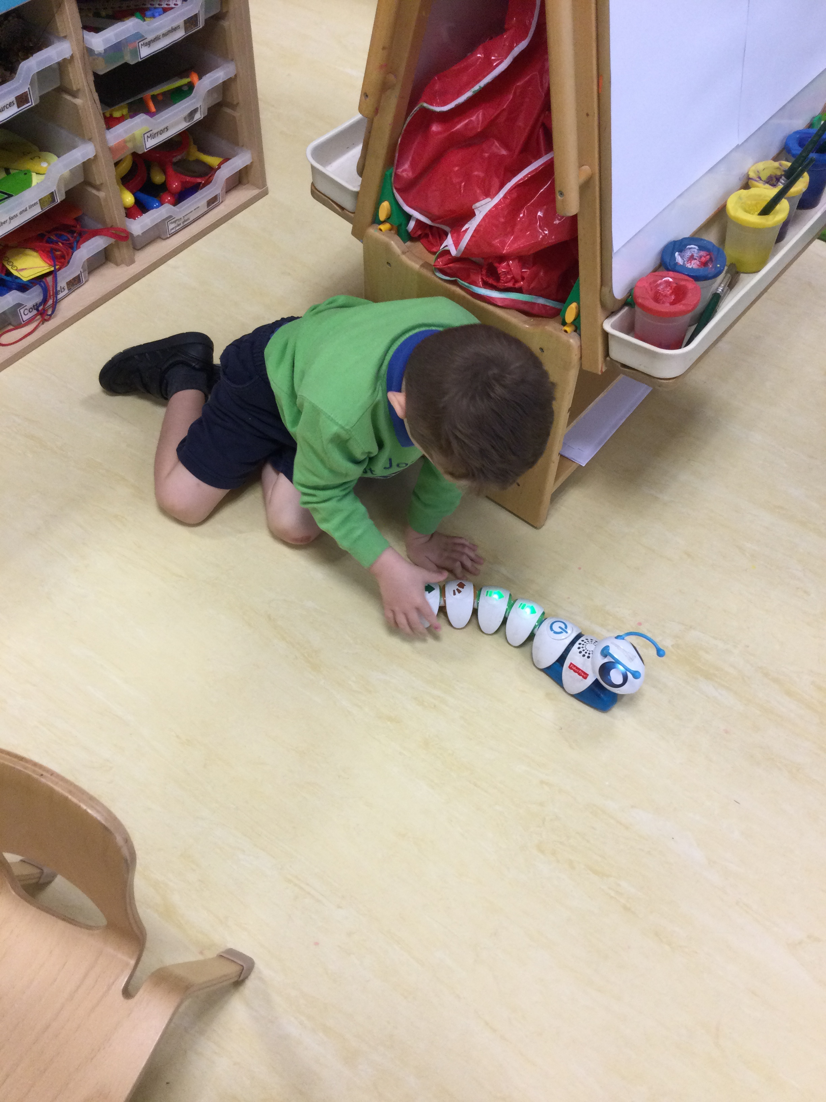
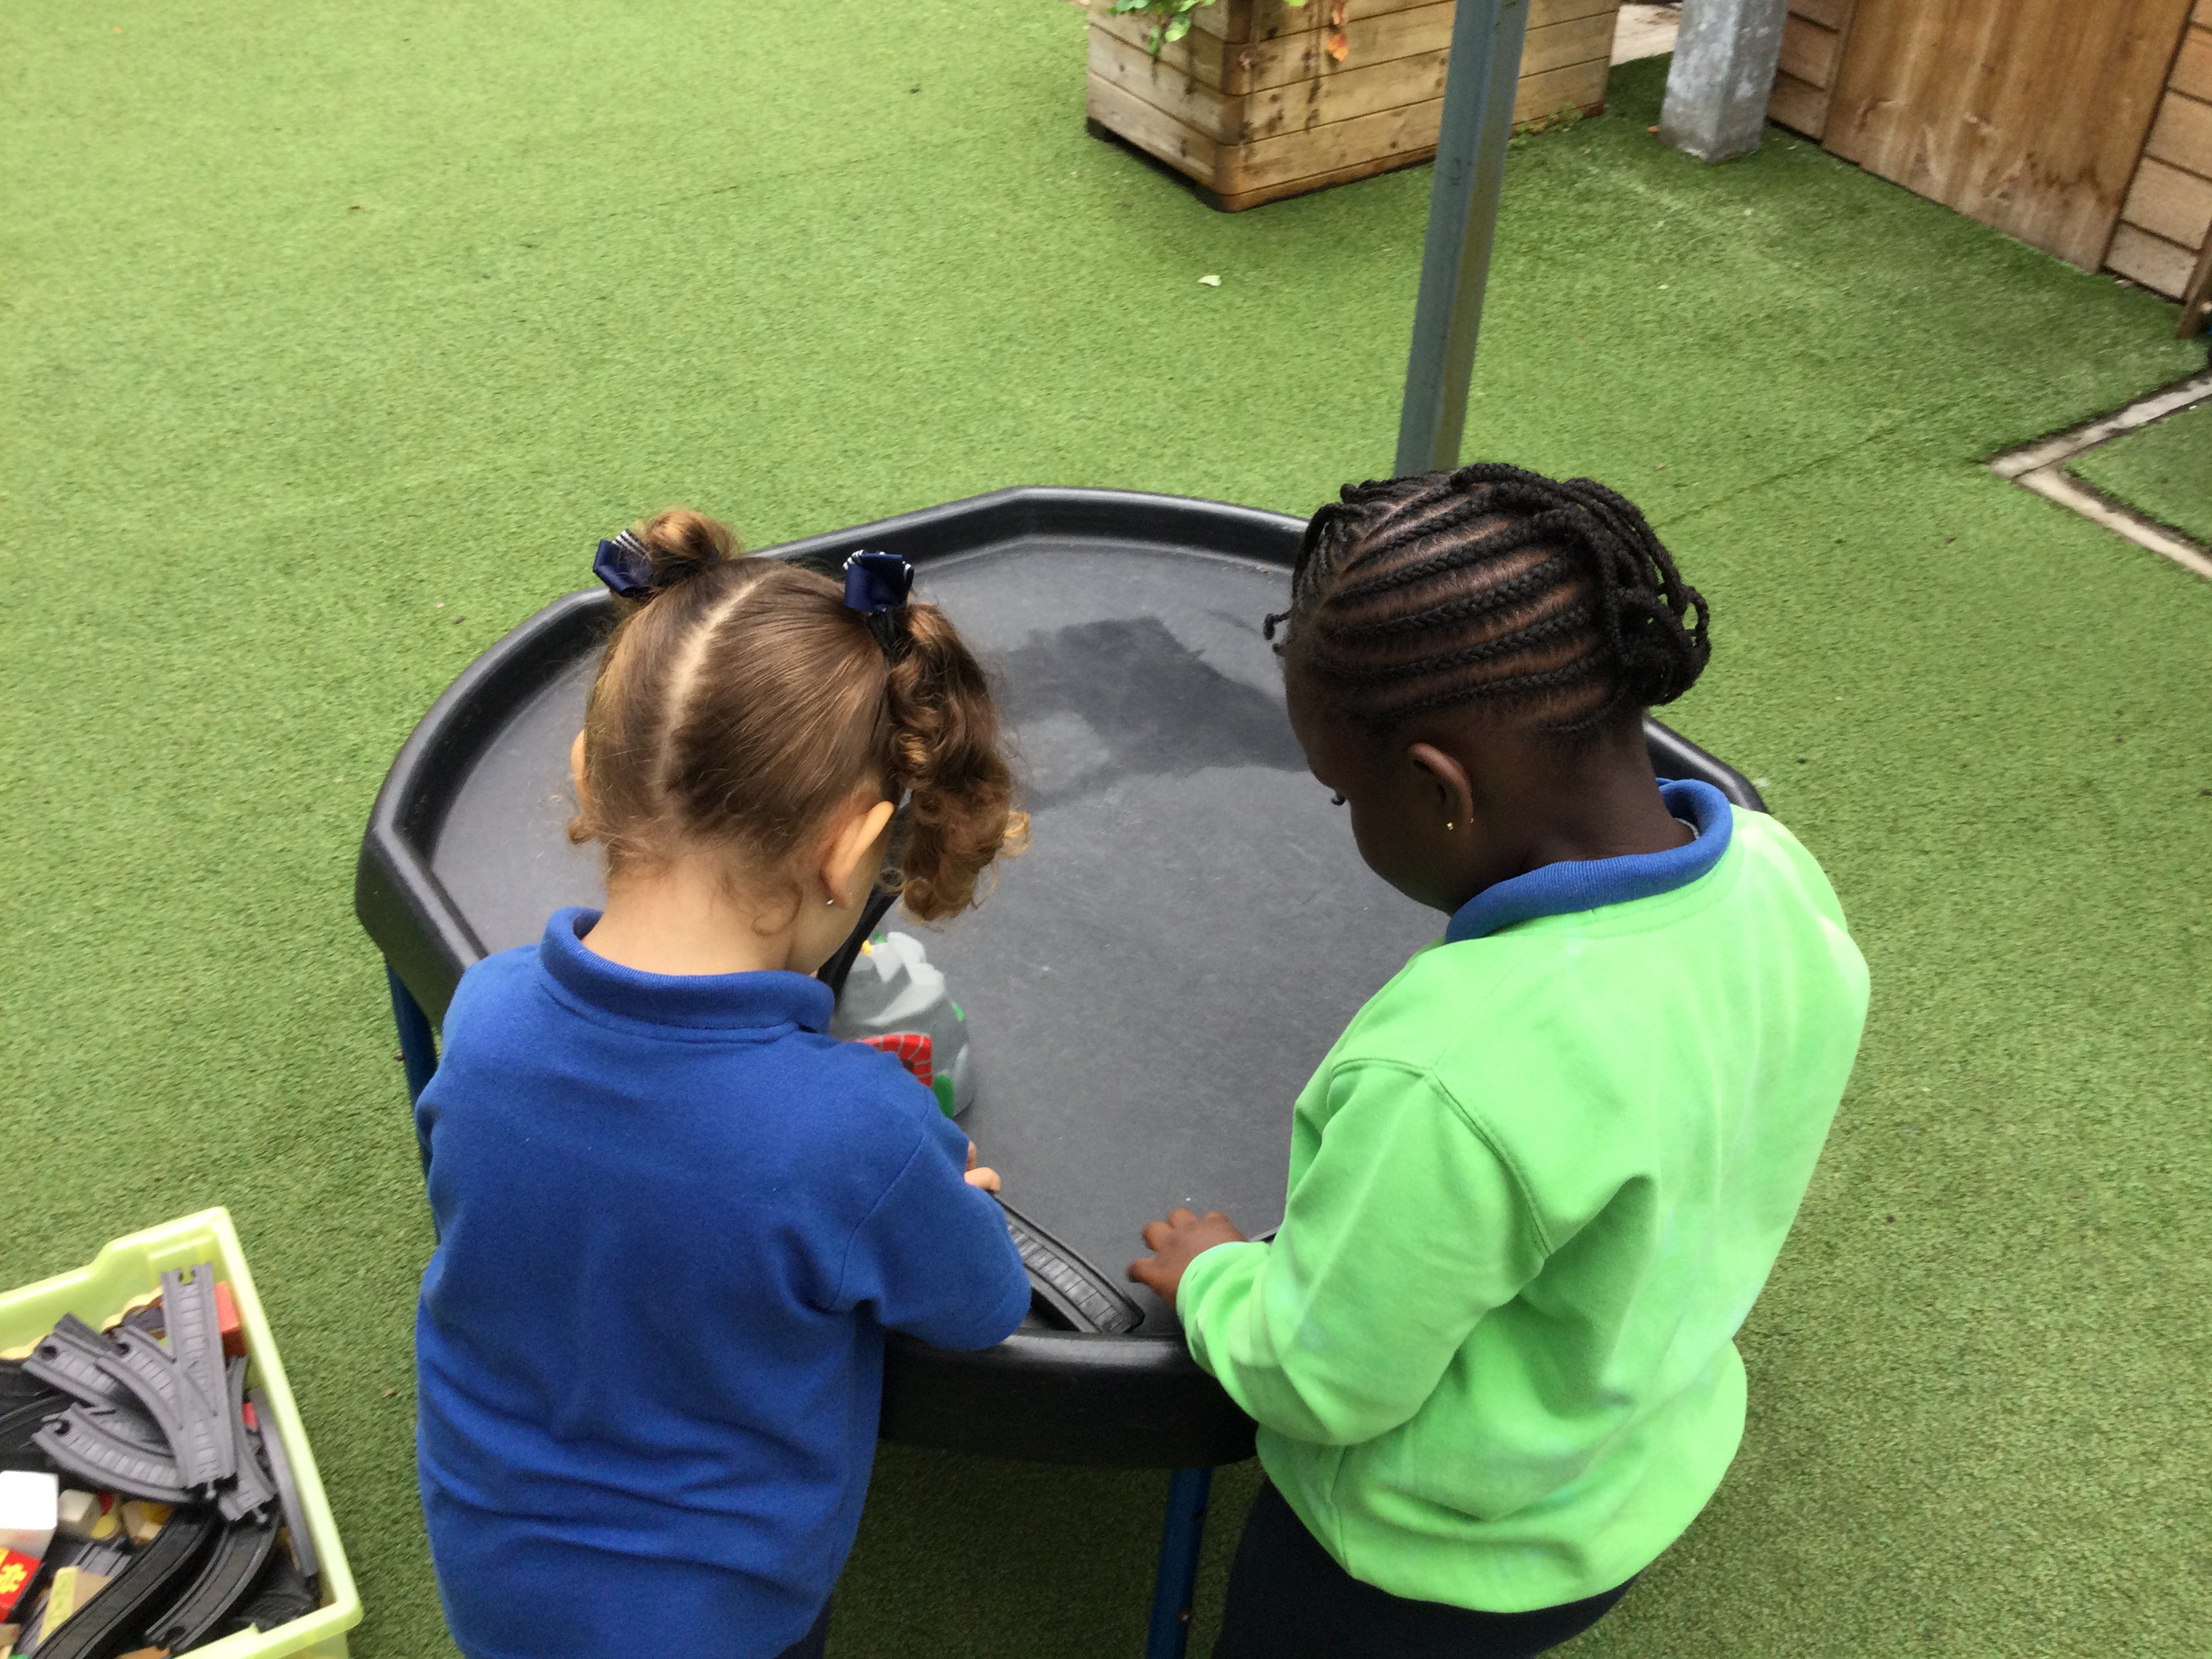
Reception Welcome Meeting

Slide 2
Our School Prayer
This is our school, let peace be found here.
Let the rooms be full of happiness.
Let love abide here,
Love for one another, love for God.
Let us remember that as many hands build a house,
So many hearts make a school.
Amen

Slide 3
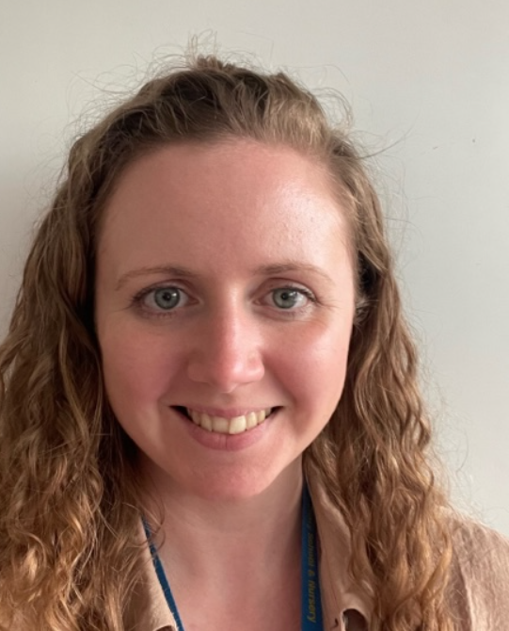
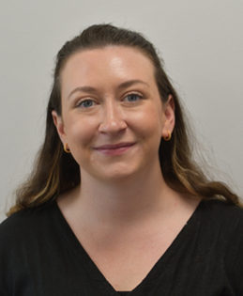
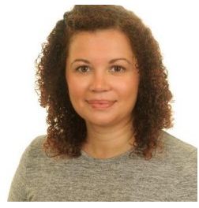
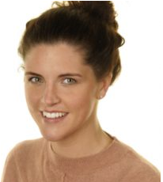
Reception Team
Miss Smith
Red Class Teacher
EYFS Phase Leader
Miss Kennedy
Ruby Class Teacher
Mrs Fulton
Teaching Assistant
Mrs Judge
Teaching Assistant
Notes:
- Reading record
- Home learning book
- star moments
Star of the week teddy and bag
Letter formation rhyme sheet

Slide 4
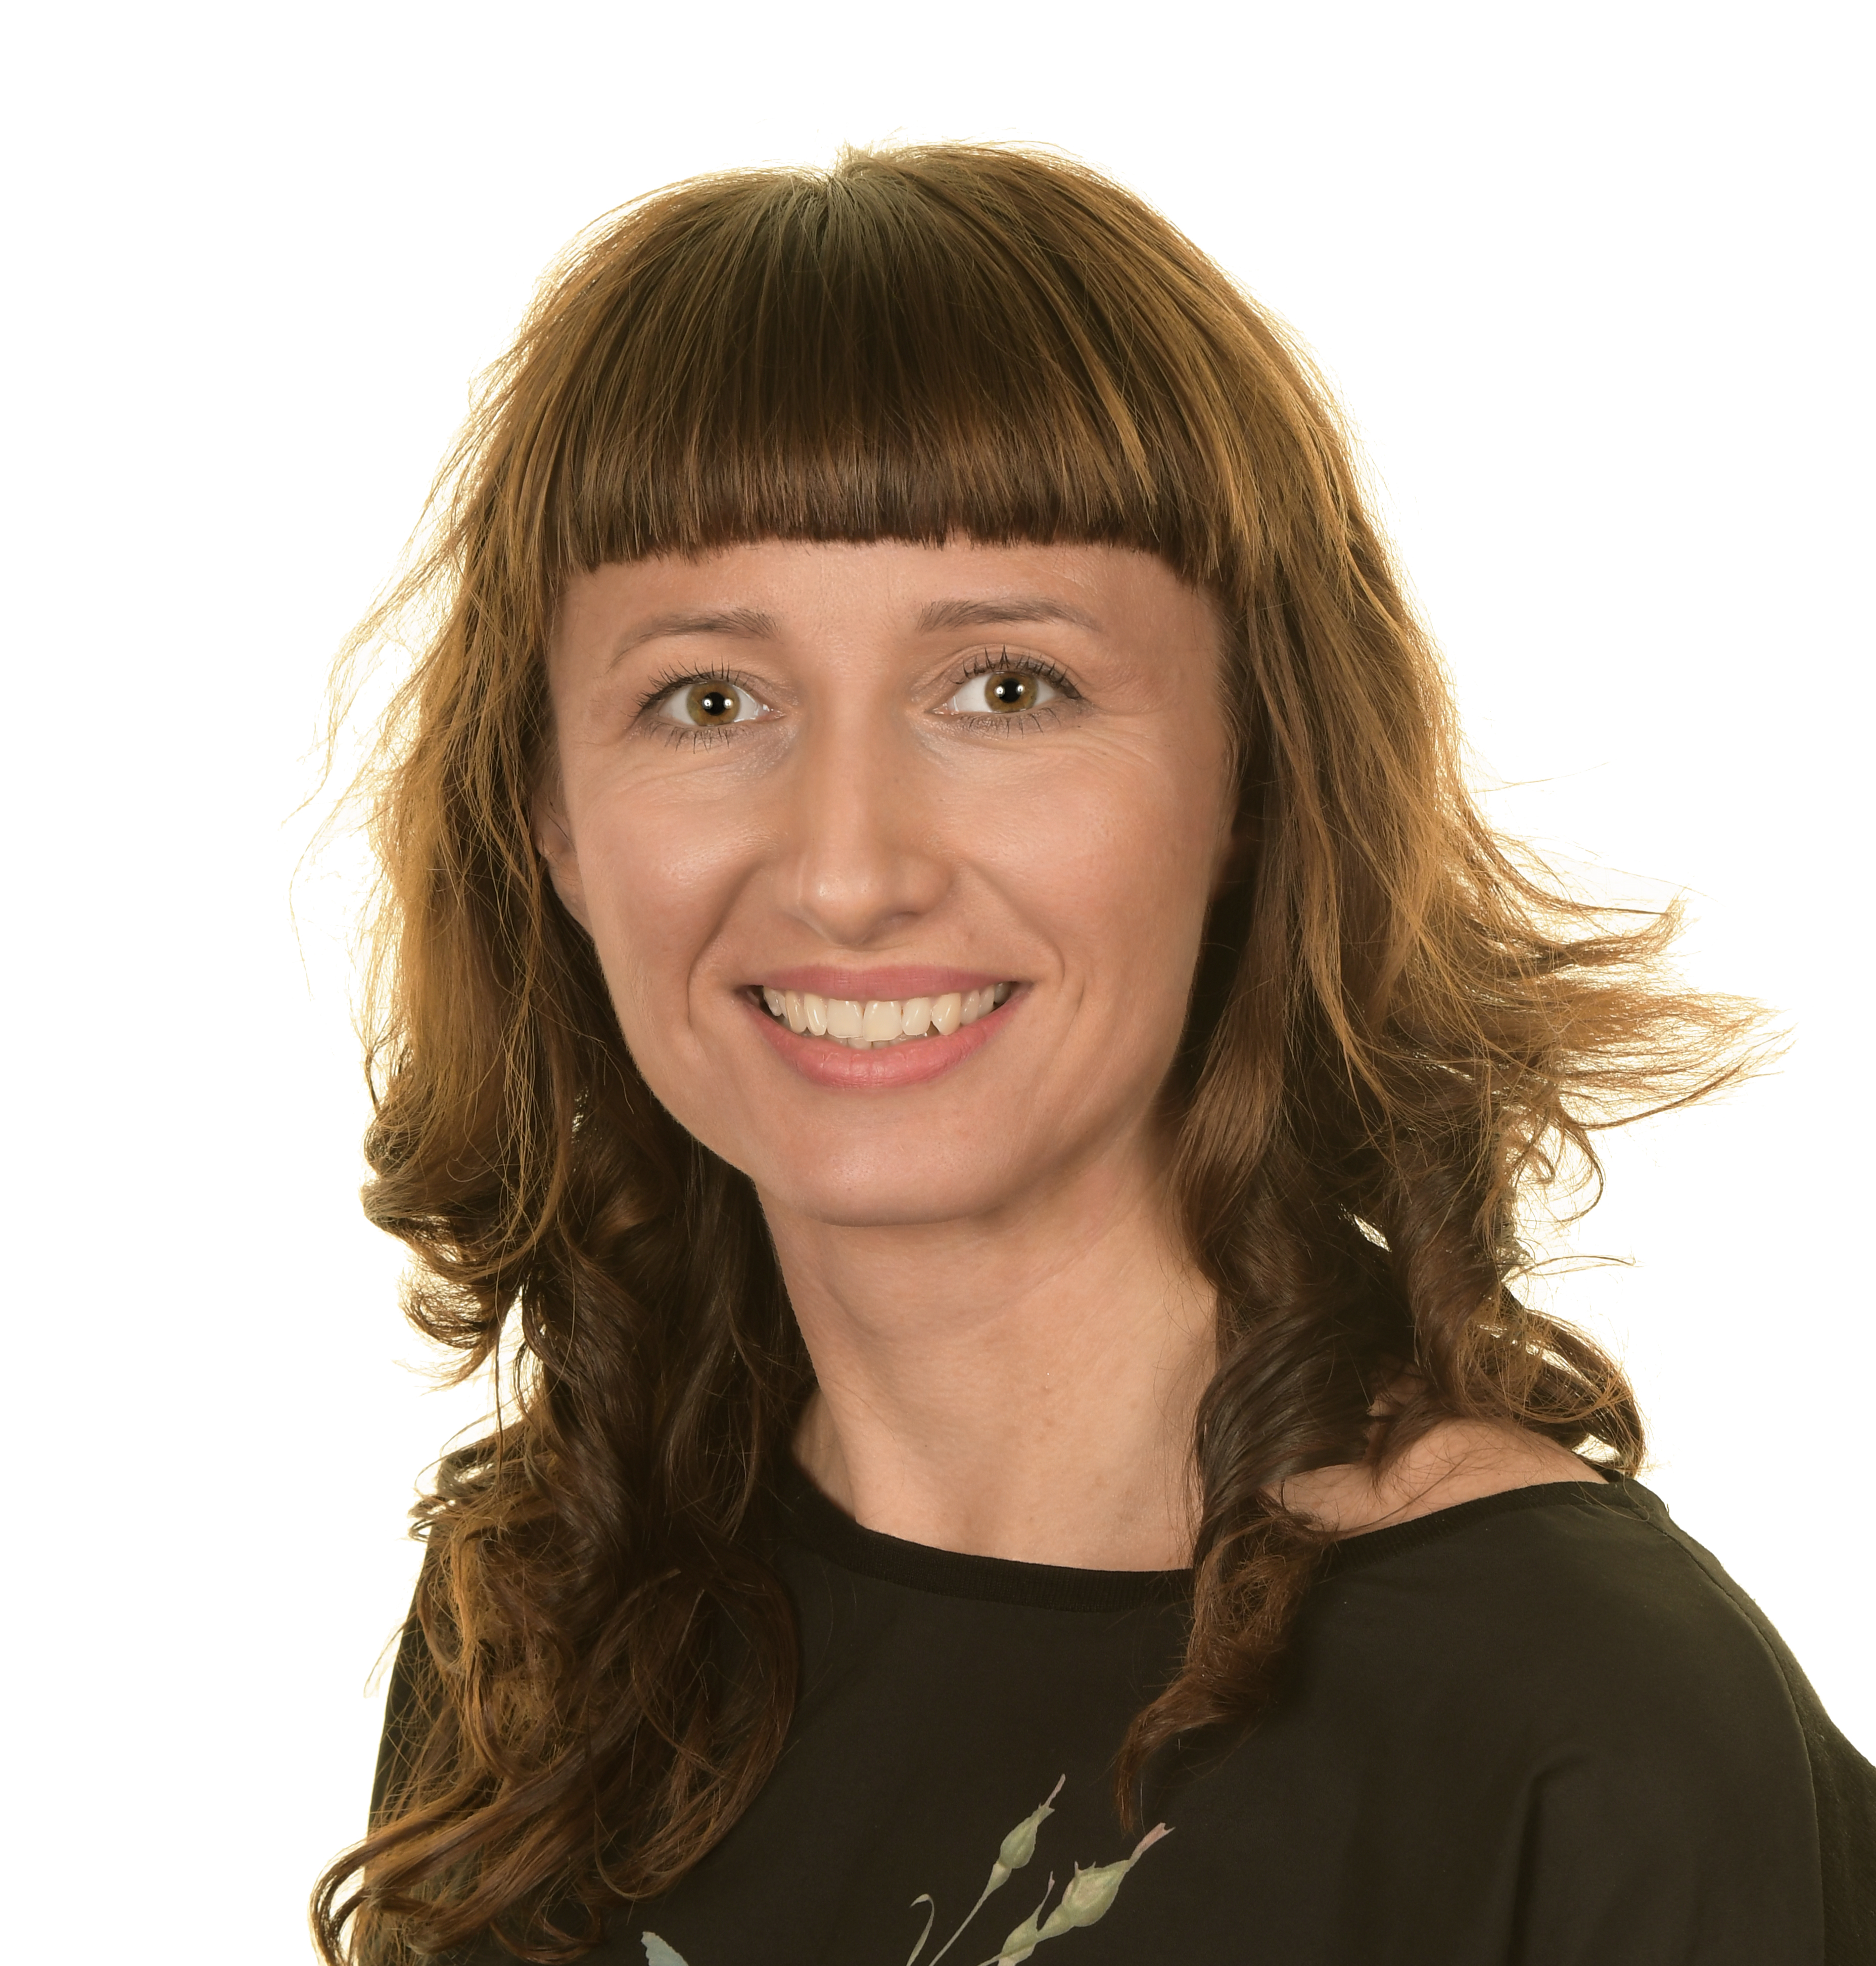
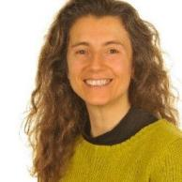
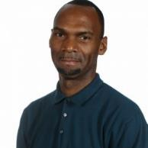
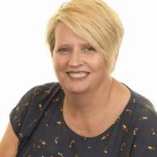
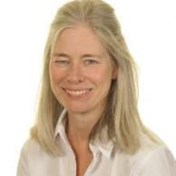
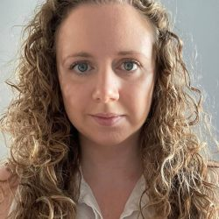
Familiar Faces
Ms Ioannou
Environmental teacher
Mr Grant
PE coach
Ms Suliga
PPA / computing teacher
Mrs Collins
Extended School Manager
Mrs Rooney
Librarian
Notes:
J

Slide 5
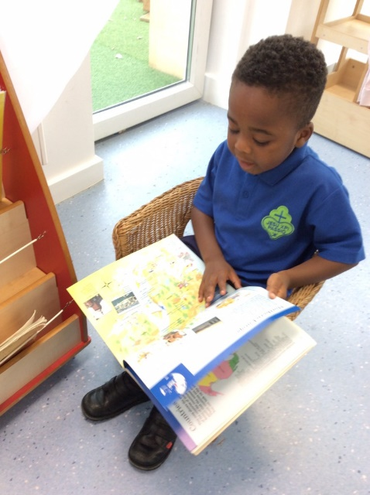
Important things to know:
Spare set of uniform clothing in your child’s locker (trousers, socks, pants, t-shirt)
All long hair to be tied back and NO NAIL VARNISH
Earrings – small pair of studs
Packed lunches – healthy school and no nuts
Please label ALL clothing items
No toys please

Slide 6
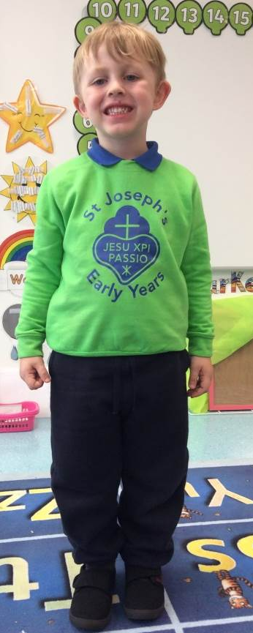
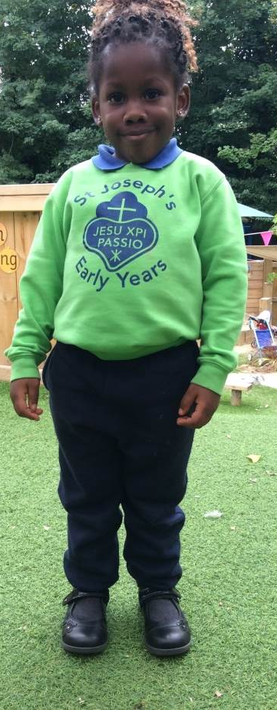
Uniform
Lime Green Sweatshirt with School Logo
Royal Blue Early Years T-Shirt
Navy tracksuit trousers or navy shorts (Summer)
Grey socks
Black school shoes (no light up shoes) – velcro please!
Wellington boots
Coat (dark colours eg. navy, black or dark grey)
Book Bag
Please ensure a spare set of (labelled) uniform is left in your child’s locker at all times in case of any accidents.

Slide 7
Important things to know:
Birthdays – Own clothes and optional treats (individually wrapped and no nuts). Birthday Book
Medication – Please ensure all medication goes through the office. Do not leave any medication in your child’s book bag.
Time to talk to your teacher is after pick up or for a longer conversation please book a meeting through the school office.

Slide 8
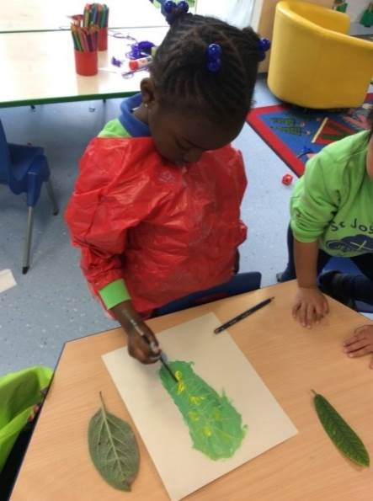
Learning Behaviours
The Catholic ethos of the school motivates us to create a peaceful an happy environment, joining in with school prayers and collective act of worship.
Positive behaviour management strategies are used throughout the Early Years by all members of staff.
Proud cloud
Praise learning behaviours and effort– “I love the way you are having a go!” “Great problem solving!”
Star of the week assembly
Communication with parents

Slide 9
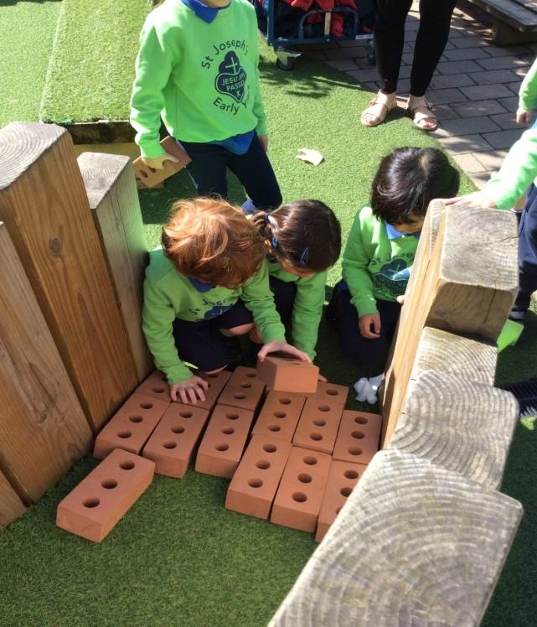
Daily Routine
School starts at 8:55am
(Soft start from 8:40)
Lunch at 11.45
School finishes at 3:15pm.
When your child is fully settled they will have access to our Extended School service, if applied for.

Slide 10
Parental Involvement
Book Bags – notes and letters
School Outings- school visits/ trips
Tapestry – online journal
Please download app if you haven’t already.
Activate account – you will be sent an activation email which may go into your junk email inbox so please check.
Notes:
Please download the app
Activate account – you will be sent an activation email which may go into your junk email inbox so please check.

Slide 11
Diary Dates Tuesday 26th September at 9.10am - Phonics sessions - You be invited to watch a phonics lesson in your child's class before a small presentation and information session. Wednesday 18th October - school closes at 1pm for parent consultations Friday 20th October 9.15am- Reception welcome liturgy Wednesday the 15th or the 22nd (to be confirmed by the museum) – Postal museum trip Friday 8th December 9.15am – Christmas Nativity

Slide 12
Library Library – Wednesday (please return the following Wednesday) Phonics books Changed every Friday P.E Is every Thursday

Slide 13
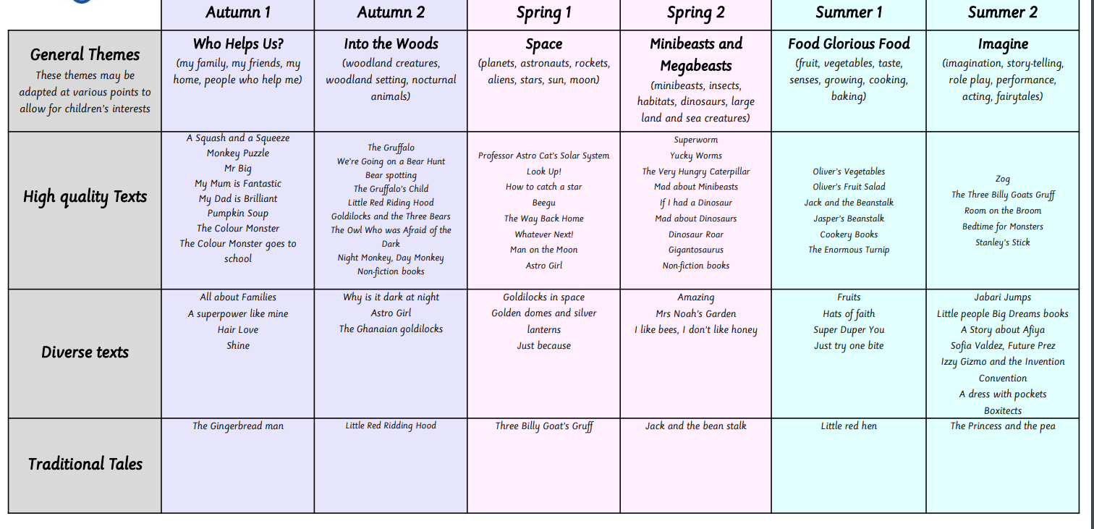
You can find our curriculum overview on the website.

Slide 14
Reading Cloud for Students
Join the student online community to:
Search the catalogue and reserve library resources online at any time
Write and share book reviews and blogs
Find out about your favourite authors and their books
Create your own reading lists
Access a huge range of eBooks (Over 1,700 shared titles & 500 audiobooks and class sets available)
Take a look at recommendations for your next read
View curricular websites and resources to help you with homework
Chat online with your school friends about what you’re reading

Slide 15
How to access Reading Cloud
Individual log-in details:
Username: 4-digit Pin
Password: Date of Birth – ddmmyyyy (02102014)
Children:
Nursery, Reception, Year 1 & Year 2: log-in details given to teachers to be shared in communications home (tapestry)
Year 3, Year 4, Year 5 & Year 6: log-in details given to children on labels to place in exercise book.

Slide 16
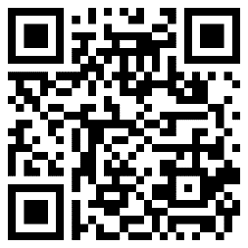
How to access Reading Cloud
Logging on:
1.Reading Cloud website: https://www.readingcloud.net/
Select: School: St Joseph’s Catholic Primary N19 5NE
2. School website: https://st-josephs.islington.sch.uk/ (follow the News tab to Library)
3. School tablets have a Reading Cloud Shortcut App
4. Reading Cloud App: iPhone, Android phone or tablet – Reading Cloud (iMLS Student)
https://apps.apple.com/my/app/imls-student/id1280515754
5. QR code

Slide 17
School Website
http://www.st-josephs.islington.sch.uk/
Check our website for our curriculum information and our blog.
Don’t forget to follow us on Twitter - @stjhighgate
Buying uniform and uniform expectations.
Parent Pay Please sign up for this in the school office!

Slide 18
Thank you for attending.
Any questions?

