Slide 1
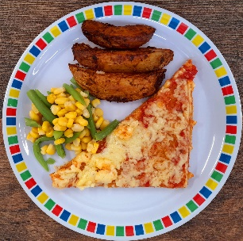
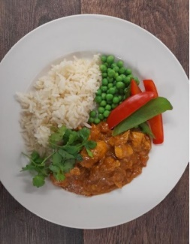
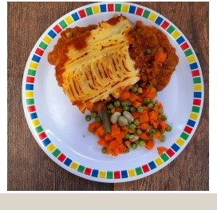
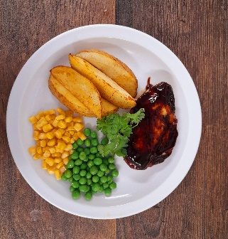
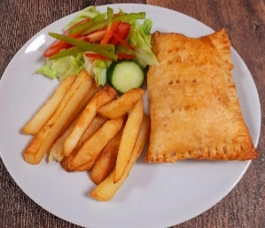
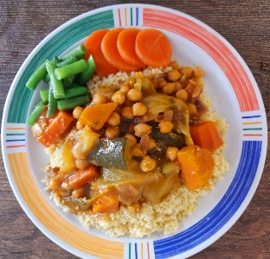
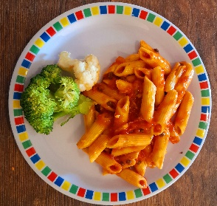
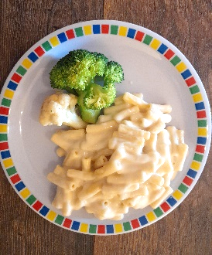
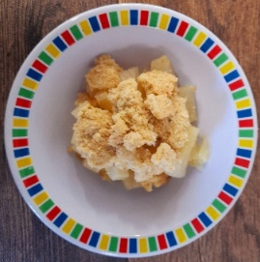
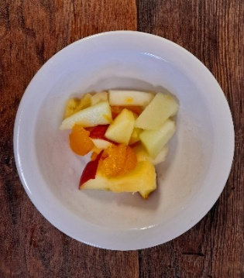
Autumn/ Winter
2023/ 2024
Cheese & Tomato Pizza
Roasted Cauliflower Curry & 50/50 Rice
Minced Beef Cottage Pie
Lentil & Roasted Vegetable Pasty with Mash & Gravy
BBQ Chicken & Chips
Chickpea Tagine with Couscous
Fishfingers with New Potatoes
Glamorgan Bean Sausages with Wedges
Chicken Arrabiata Pasta
Mac & Cheese
Pear Crumble with Custard
Yoghurt & Fruit station
Mandarin Cheesecake
Banana Loaf
Yoghurt & fruit Station

Slide 2
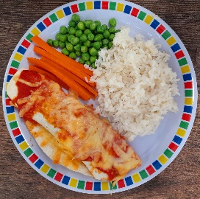
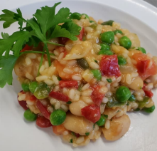
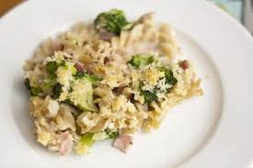
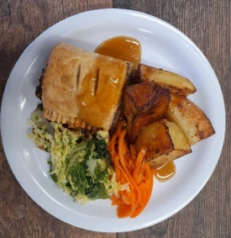
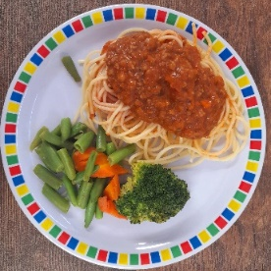
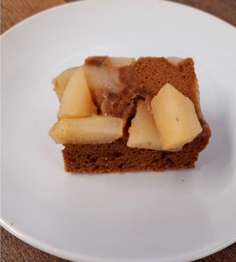
Autumn/ Winter
2023/ 2024
Golden Tortilla Stack
Mexican Bean Fajitas with 50/50 Rice
Roast Chicken & Roast Potatoes with Gravy
Chicken Sausages with Mash & Gravy
Butterbean Risotto
Broccoli Pasta Bake
Beef Lasagne
Lentil Wellington with Skin on Roast Potatoes & Gravy
Spaghetti Bolognaise
Battered Fish & Chips
Eves Pudding with Custard
Pear and Ginger Slice
Yoghurt & Fresh Fruit
5 a DAY Cake
Yoghurt & Fresh Fruit Station

Slide 3
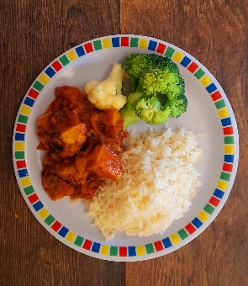
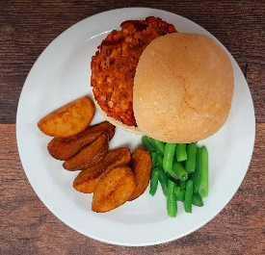
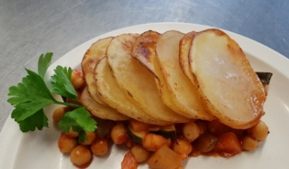
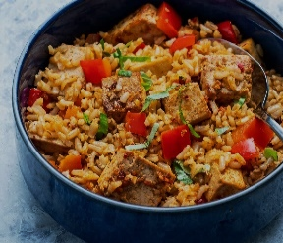
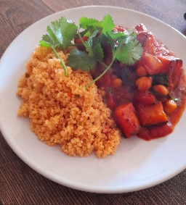
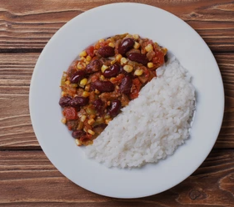
Autumn/ Winter
2023/ 2024
Sweet & Sour Butterbean with 50/50 Rice
Spicy Bean burger with wedges
Roast Turkey,Roast Potatoes & Gravy
Roasted Vegetable Pizza
Salmon Fishfingers & Chips
Chickpea & Vegetable Hot Pot with Mash Potato
Chicken Tagine with Couscous
Jollof Rice, Quorn & Beans
Chilli Con Carne with
50/50 Rice
Mexican Enchiladas & Rice
Yoghurt & Fruit Station
Apple and Raisin Strudel
Peach Upside Down Cake with Custard
Yoghurt & Fruit Station
Rice Pudding with Fruit Compote

