Slide 1
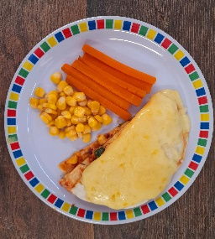
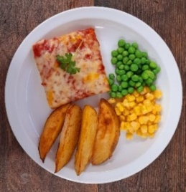
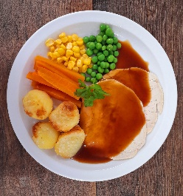
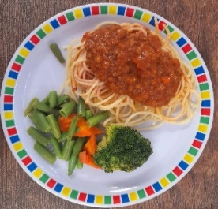
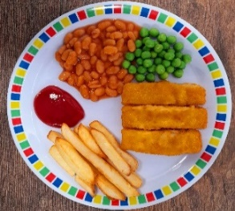
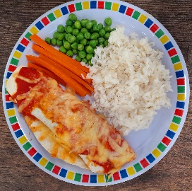
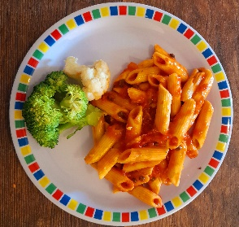
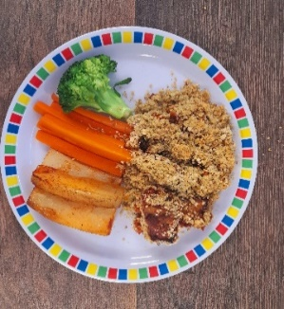
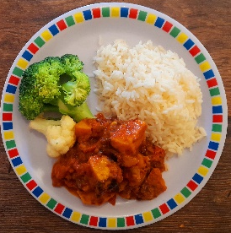
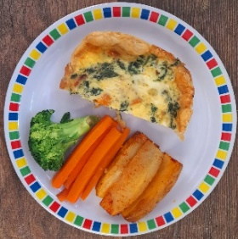
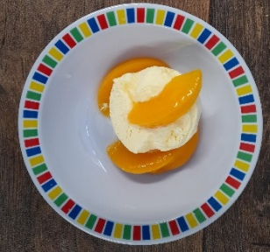
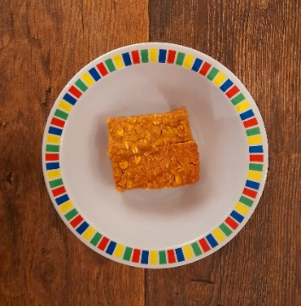
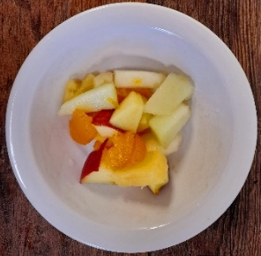
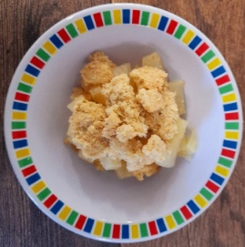
Beef Tortilla Stack with Rice
Chicken and Red Pepper Pizza
Roast Turkey, Roast Potatoes & Gravy
Soya Spaghetti Bolognaise
Fishfingers with Chips
Vegetable Enchiladas with Rice
Arrabiata Tomato Pasta
Vegan Mediterranean Gratin & New Potatoes
Roasted Cauliflower Curry with Rice
Cheese and Tomato Quiche with Chips
Peaches & Ice Cream
Apple & Raisin Flapjack
Yoghurt & Fruit Station
Mixed Fruit Crumble with Custard
Yoghurt & Fruit Station

Slide 2
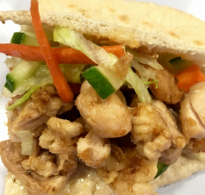
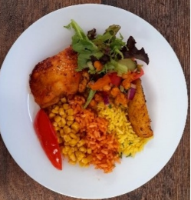
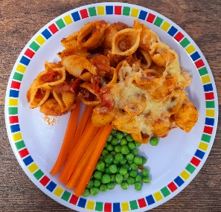
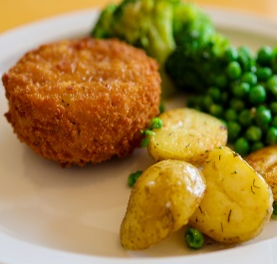
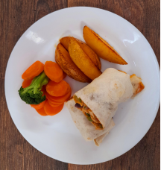
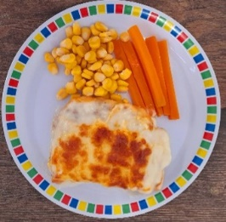
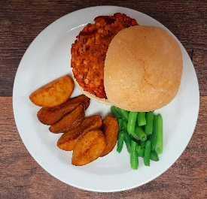
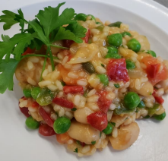
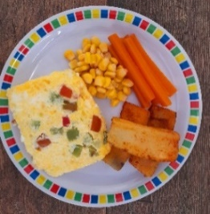
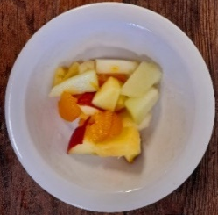
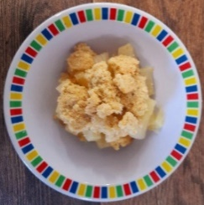
Lemon Turkey Stuffed
Pitta Pocket
Jerk Chicken with Rice
Minced Beef Pasta Bake
Cheese and Tomato Pizza
Salmon Fishcakes & Sweet Potato Wedges
Vegetable and Bean Fajitas with Rice
Vegetable Lasagne with Garlic Bread
Bean and Lentil Burger in a Bun
Summer Vegetable Risotto
Red Pepper & Cheese Frittata & Chips
Fruity Shortbread
Mandarin Cheesecake
Yoghurt & Fresh Fruit Station
Apple Crumble with Custard
Yoghurt & Fresh Fruit Station

Slide 3
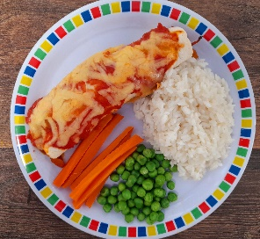
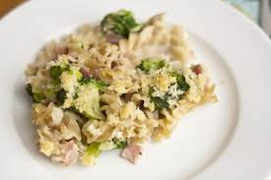
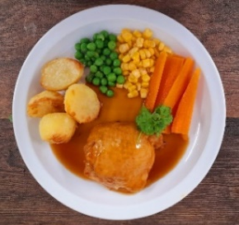
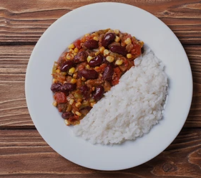
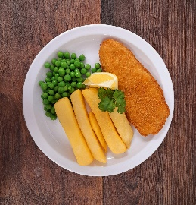
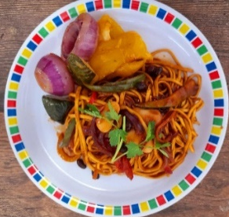
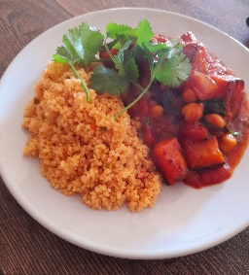
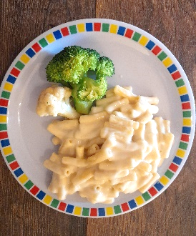
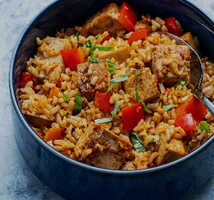
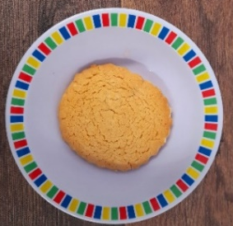
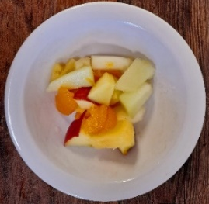
Chicken Enchiladas with Potato Wedges
Broccoli Pasta Bake
Honey & Lemon Chicken, Roast Potatoes & Gravy
Chilli con Carne with Rice
Breaded Fish and Chips
NEW Veg Chinese Vegetable Noodles
Vegetable & Apricot Tagine with Couscous
Mac and Cheese
Jollof Rice with Quorn and Beans
Spanish Omelette & Chips
Orange and Cinnamon Cookie
Mandarin Jelly
Yoghurt & Fresh Fruit Station
Mixed Fruit Crumble with Custard
Yoghurt & Fresh Fruit Station

