Slide 1
Leadership and management
Clare McFlynn
&
Angela Noronha

Slide 2
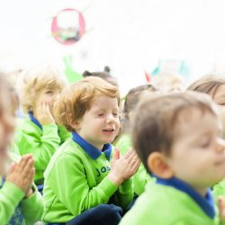
School Prayer
This is our school, Let peace be found here, Let the rooms be full of happiness, Let love abide here, Love for one another, Love for God. Let us remember, That as many hands build a house, So many hearts make a school. Amen

Slide 3
How does that affect St. Joseph’s
Outstanding schools will no longer be exempt. Inspection will most likely take place in next academic year
Outstanding schools may be inspected under Section 8 at any time with a subject specific inspection

Slide 4
Leadership and Management (Ofsted Sept 2019)
Includes Governance.
leaders’ high expectations of all pupils in the school, and the extent to which these are embodied in leaders’ and staff’s day-to-day interactions with pupils
the extent to which leaders focus their attention on the education provided by the school.
whether continuing professional development for teachers and staff is aligned with the curriculum this develops teachers’ content knowledge and teaching content knowledge over time, and the extent to which, so that they are able to deliver better teaching for pupils
the extent to which leaders create coherence and consistency across the school so that pupils benefit from effective teaching and consistent expectations, wherever they are in the school
whether leaders seek to engage parents and their community thoughtfully and positively in a way that supports pupils’ education. Also, whether leaders are thoughtful in drawing boundaries and resisting inappropriate attempts to influence what is taught and the day-to-day life of the school
the extent to which leaders take into account the workload and well-being of their staff, while also developing and strengthening the quality of the workforce
the extent to which leaders’ and managers’ high ambitions are for all pupils, including those who are harder to reach. This includes ensuring that practices such as ‘off-rolling’ do not take place and that the way the school uses the pupil premium is founded on good evidence.
whether leaders and those responsible for governance all understand their respective roles and perform these in a way that enhances the effectiveness of the school.

Slide 5
TO BE OUTSTANDING (Ofsted Sept. 2019)
The school meets all the criteria for good in leadership and management securely and consistently.
Leadership and management are exceptional.
In addition, the following apply:
Leaders ensure that teachers receive focused and highly effective professional development. Teachers’ subject, pedagogical and pedagogical content knowledge consistently build and develop over time. This consistently translates into improvements in the teaching of the curriculum.
Leaders ensure that highly effective and meaningful engagement takes place with staff at all levels and that issues are identified. When issues are identified, in particular about workload, they are consistently dealt with appropriately and quickly.
Staff consistently report high levels of support for well-being issues.

Slide 6
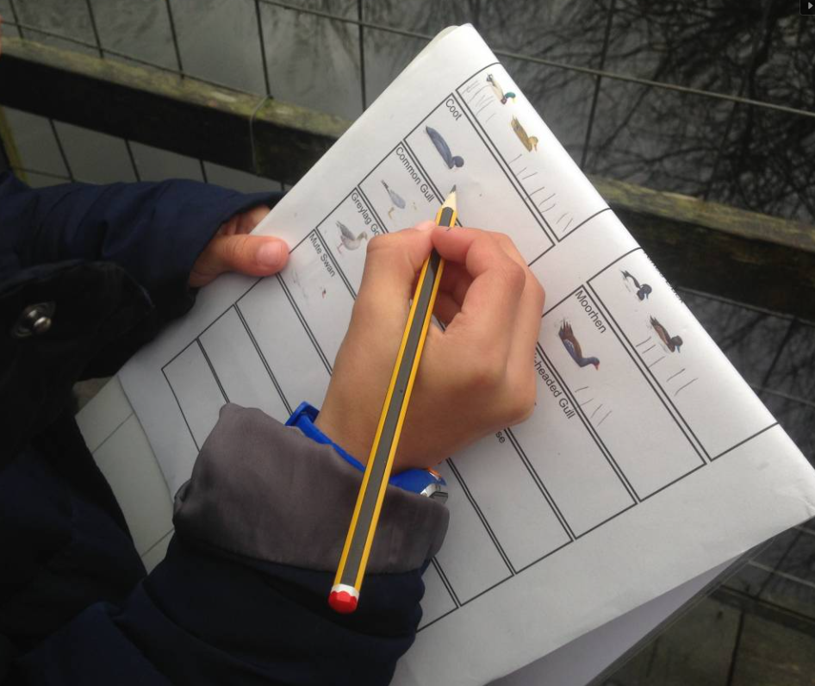
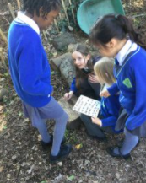
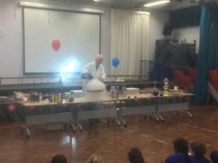
LEARNING IMPROVEMENT PLAN (LIP) Priorities
2021-2022

Slide 8
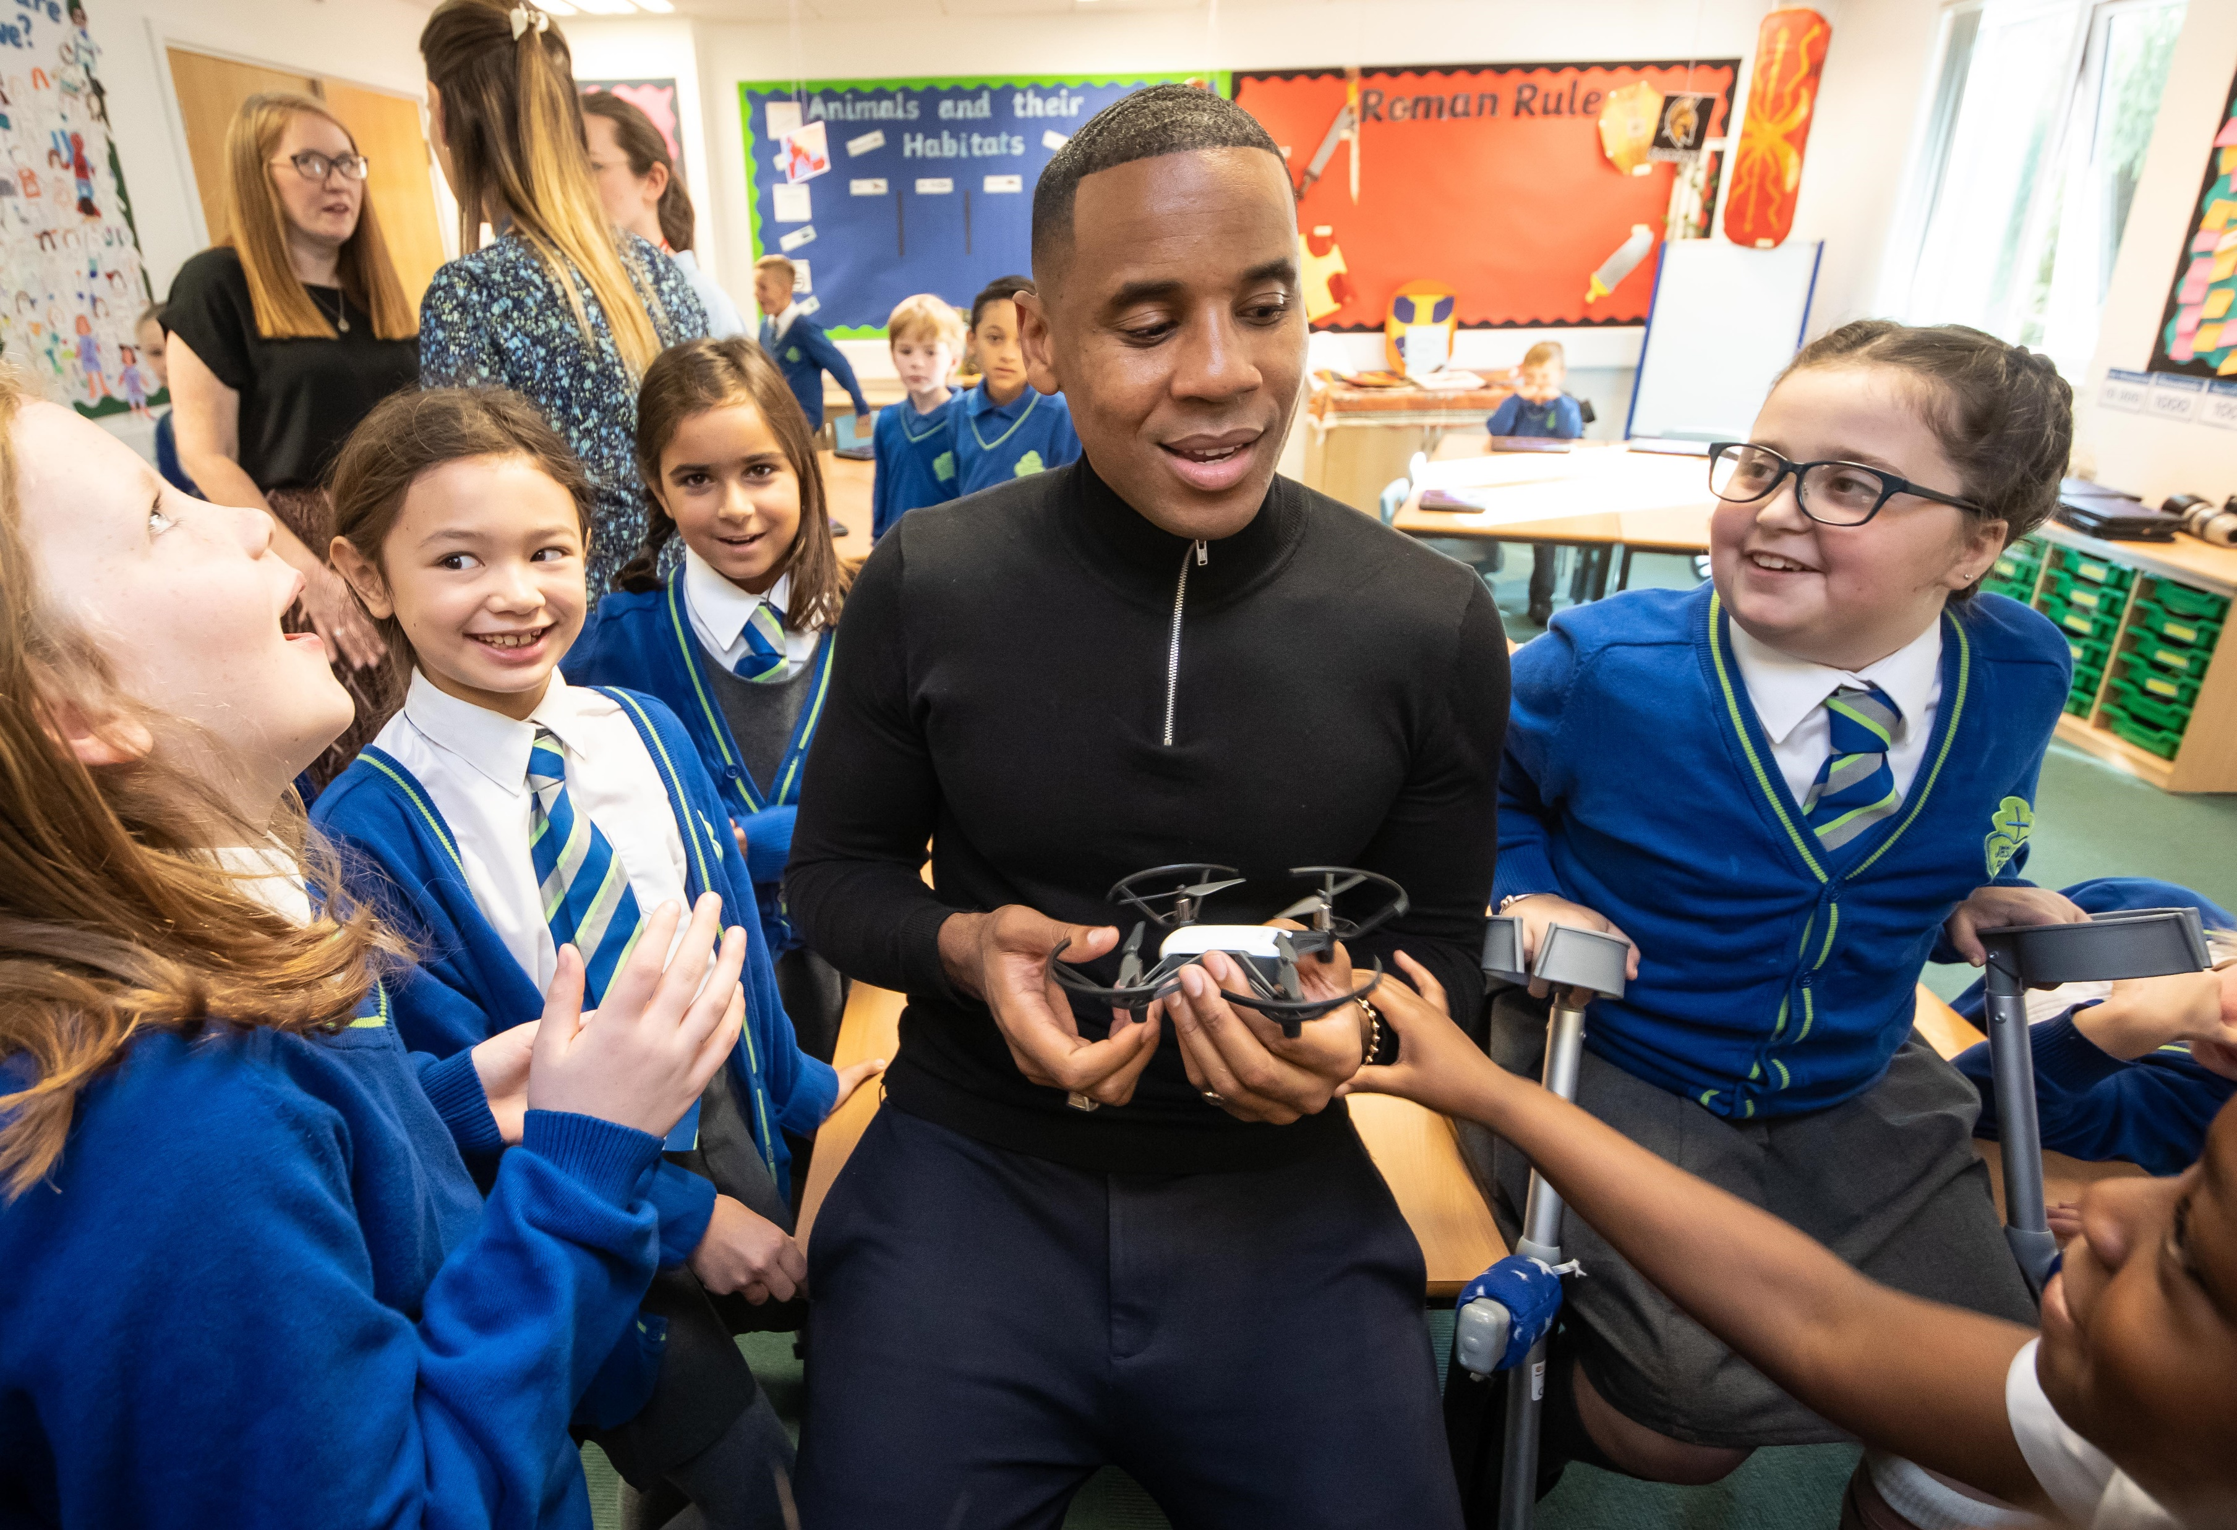
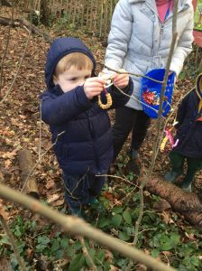
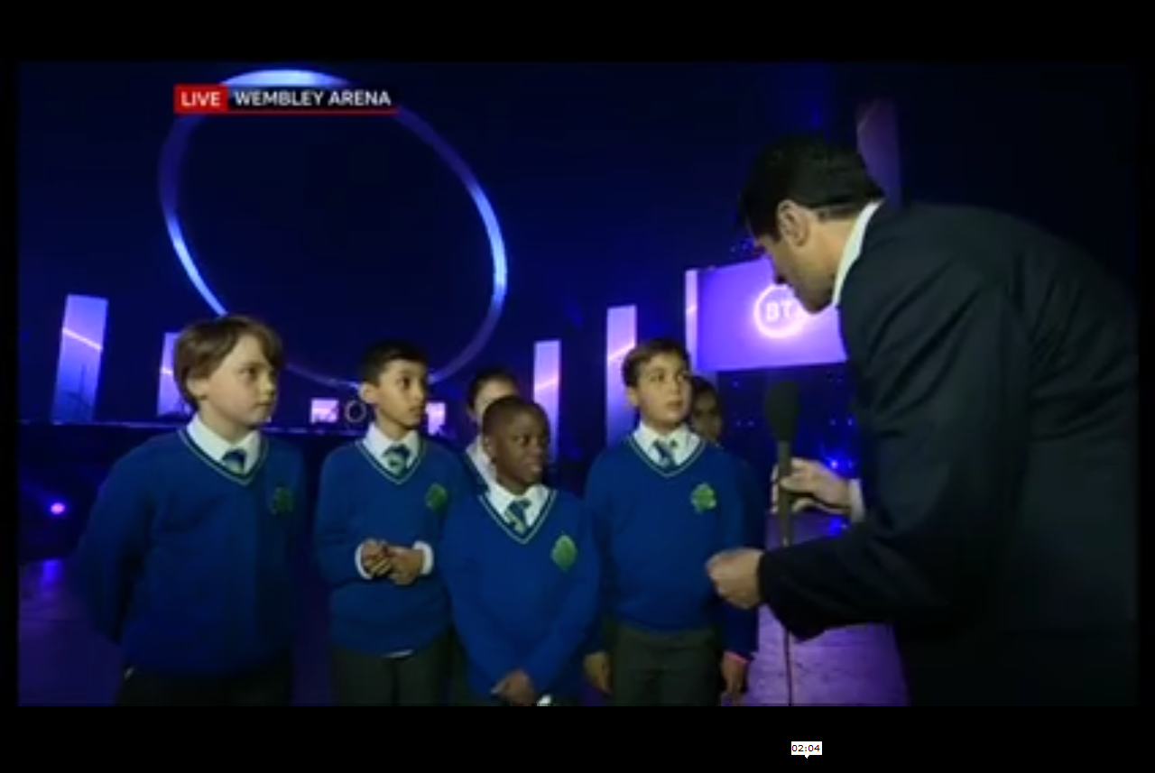

Slide 10
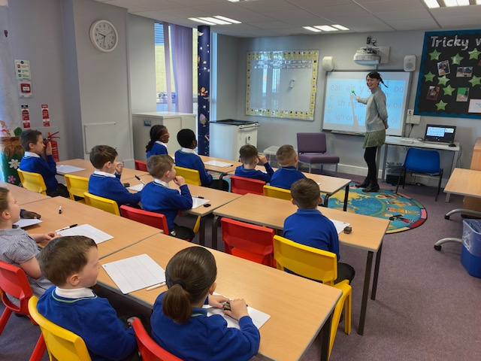
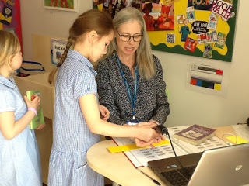
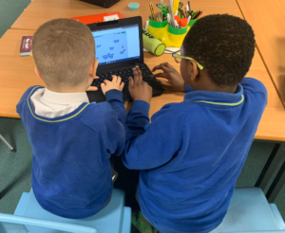
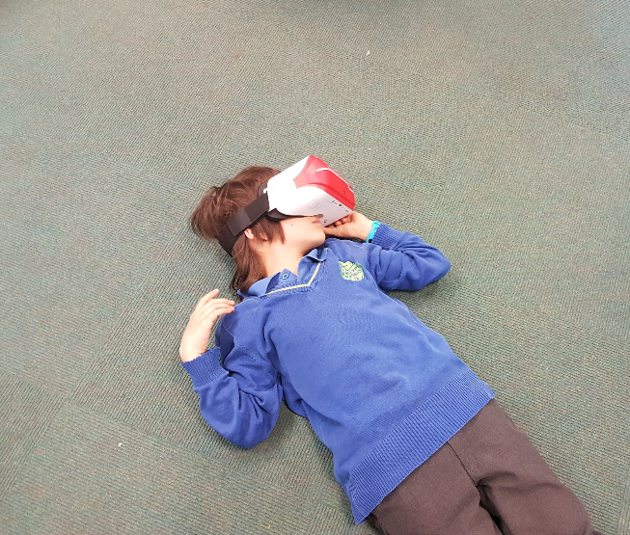
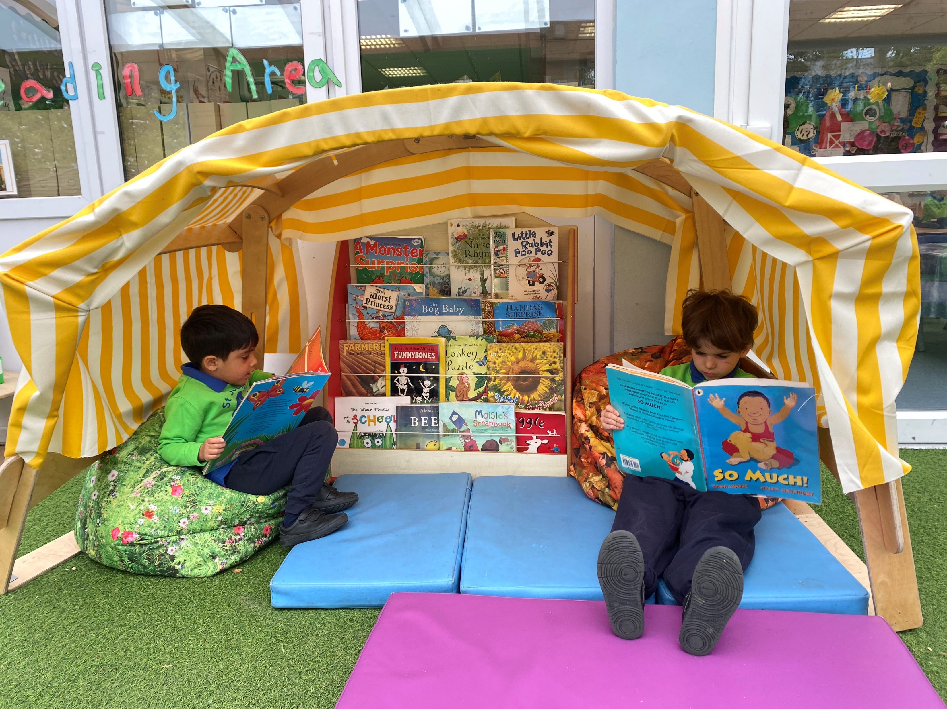

Slide 11
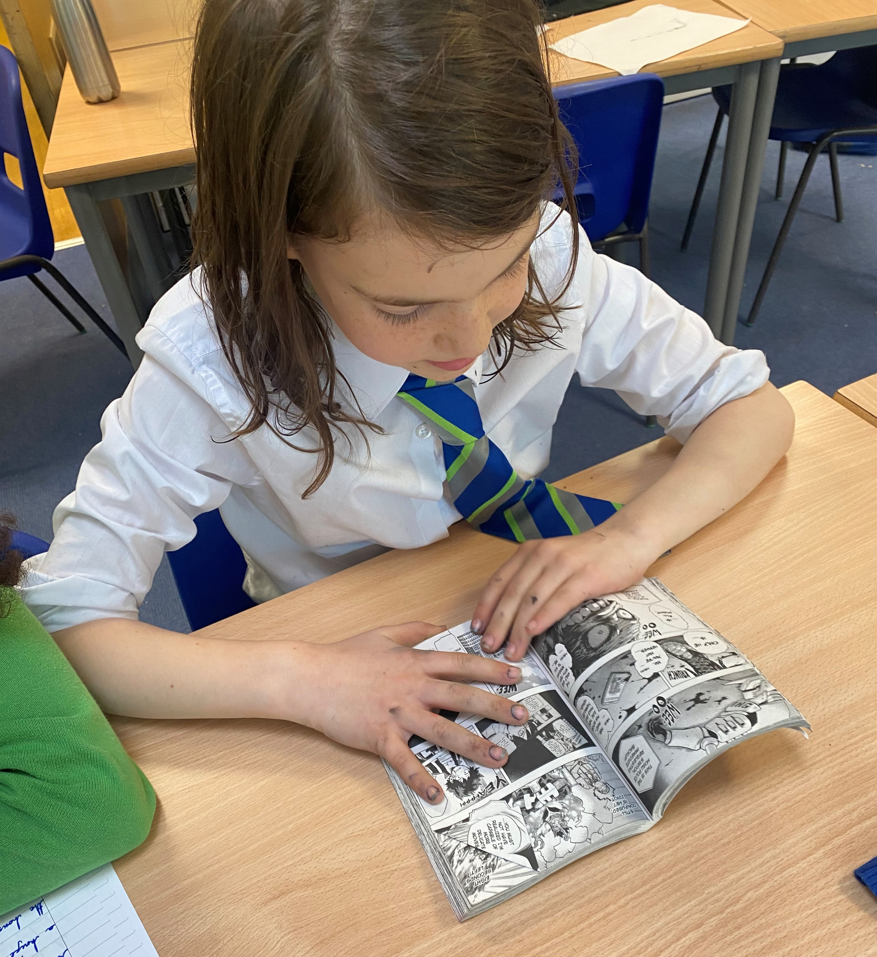
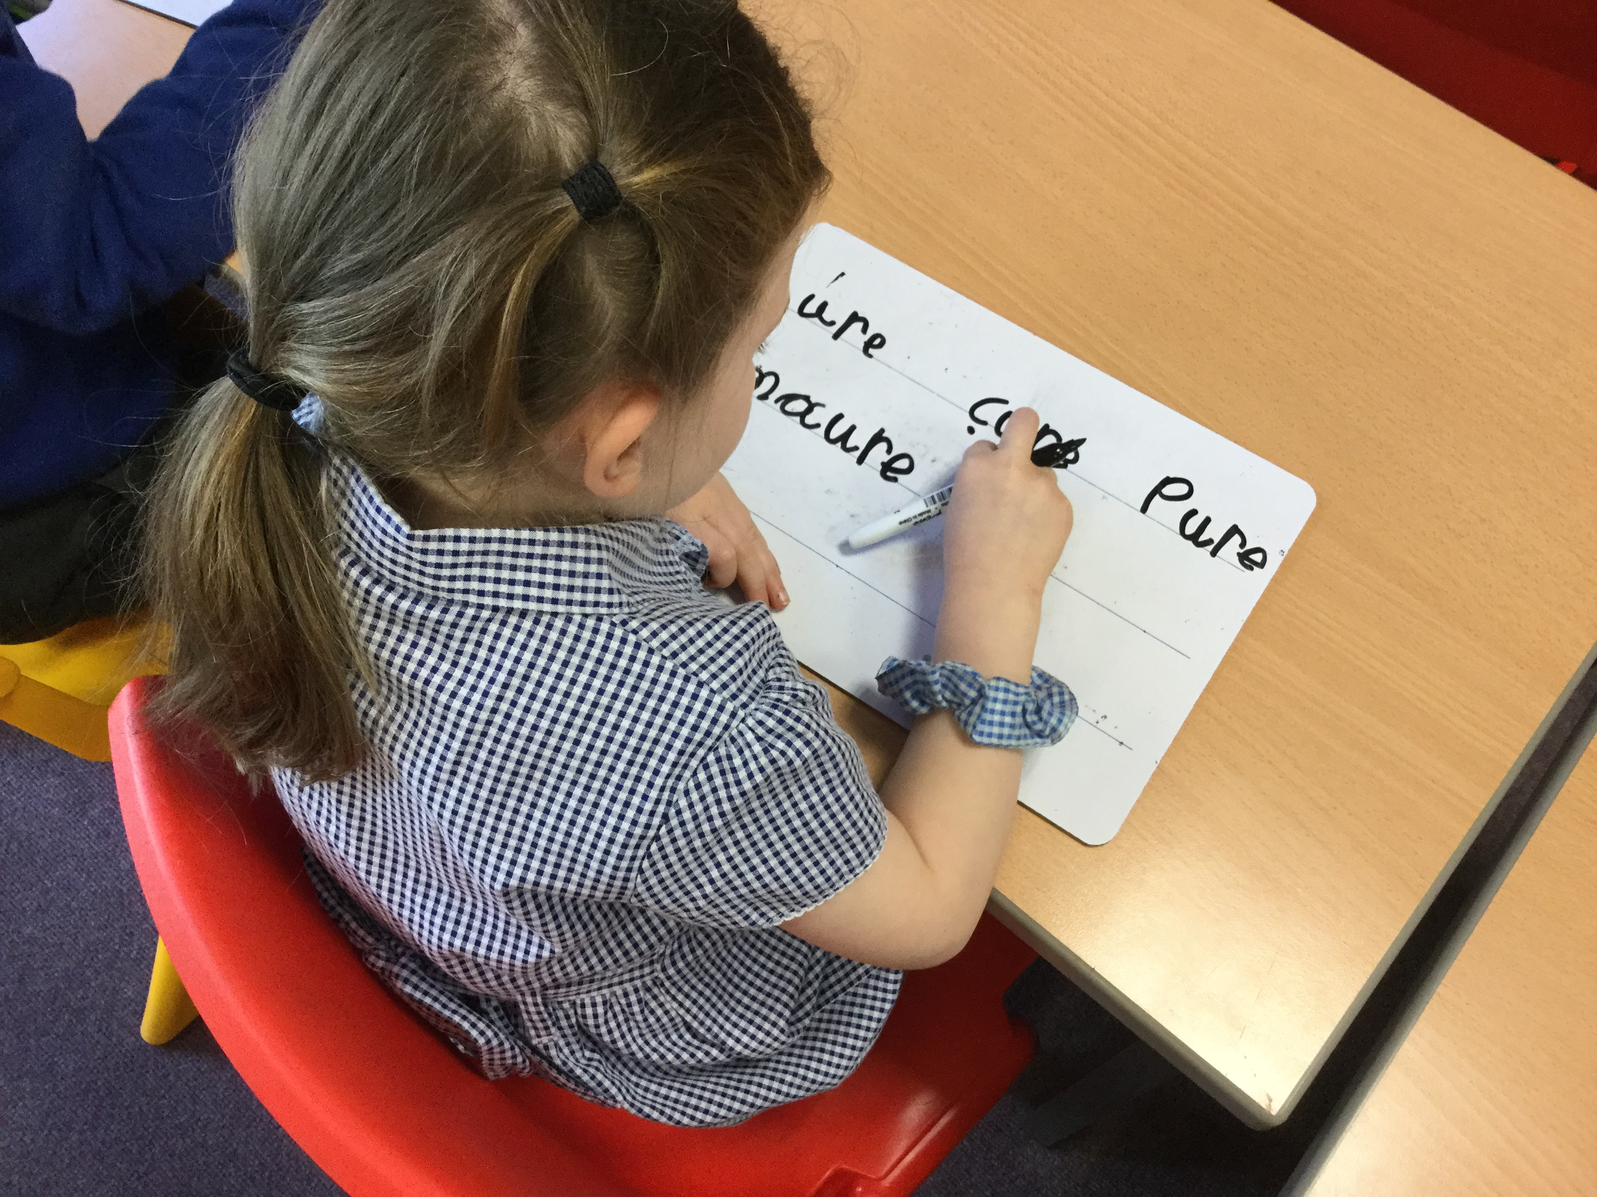
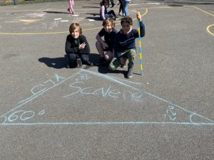
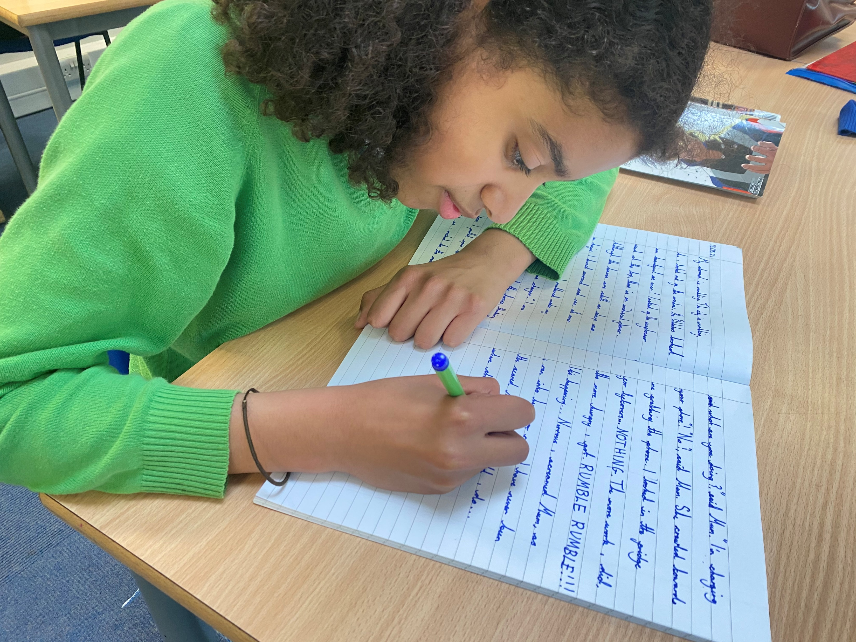
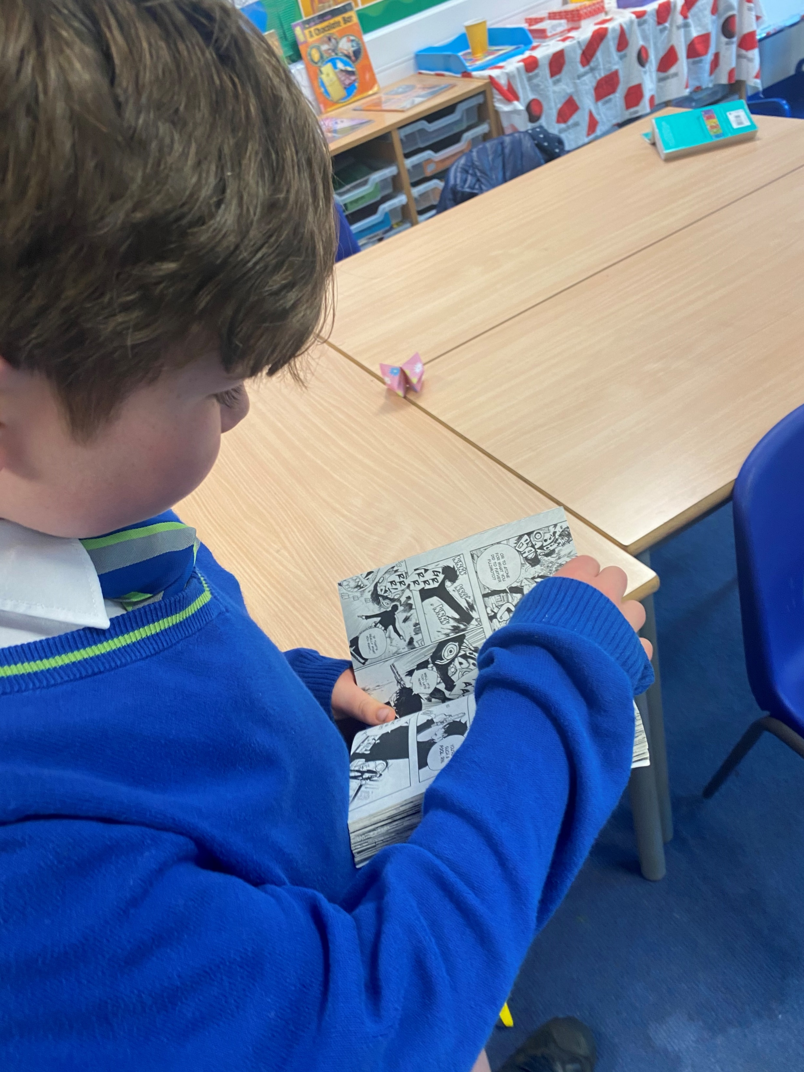

Slide 12
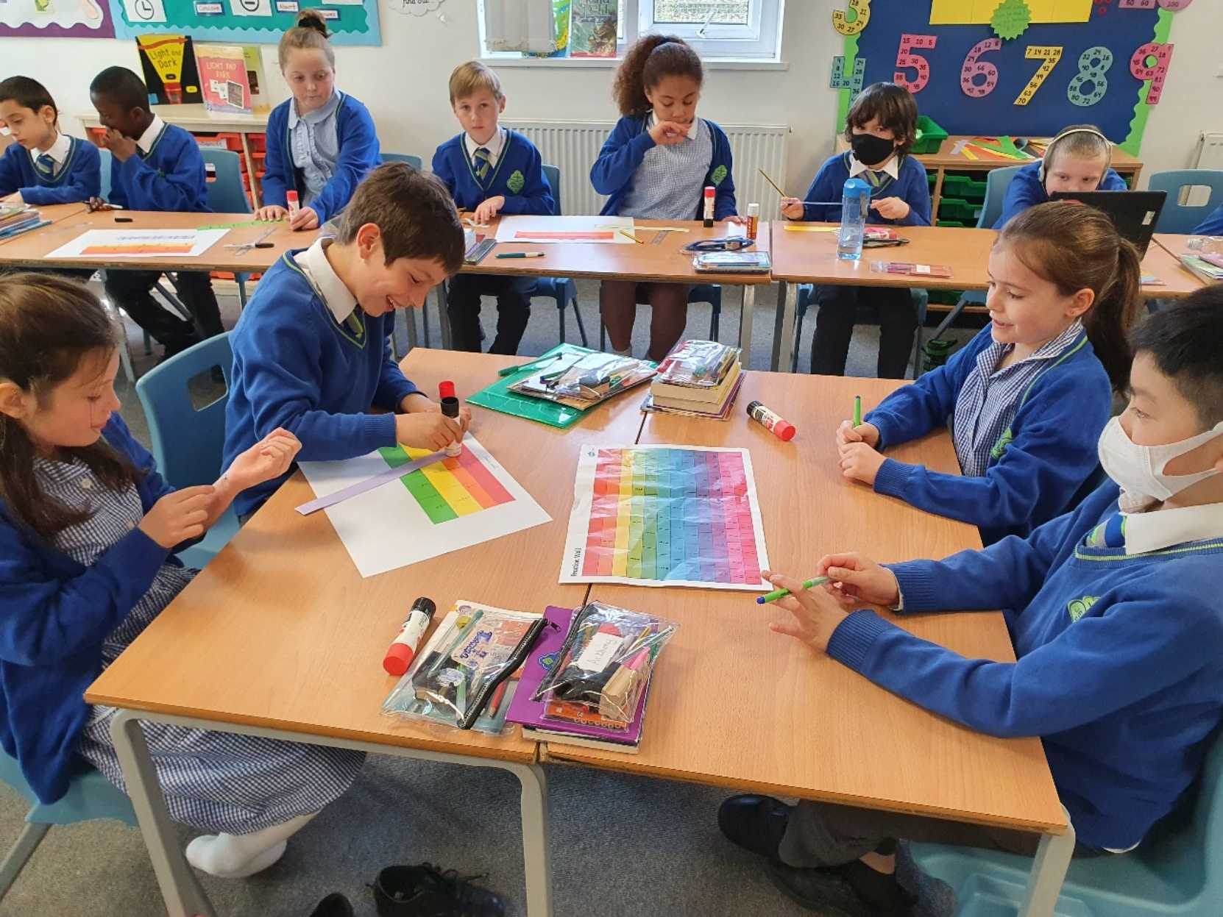
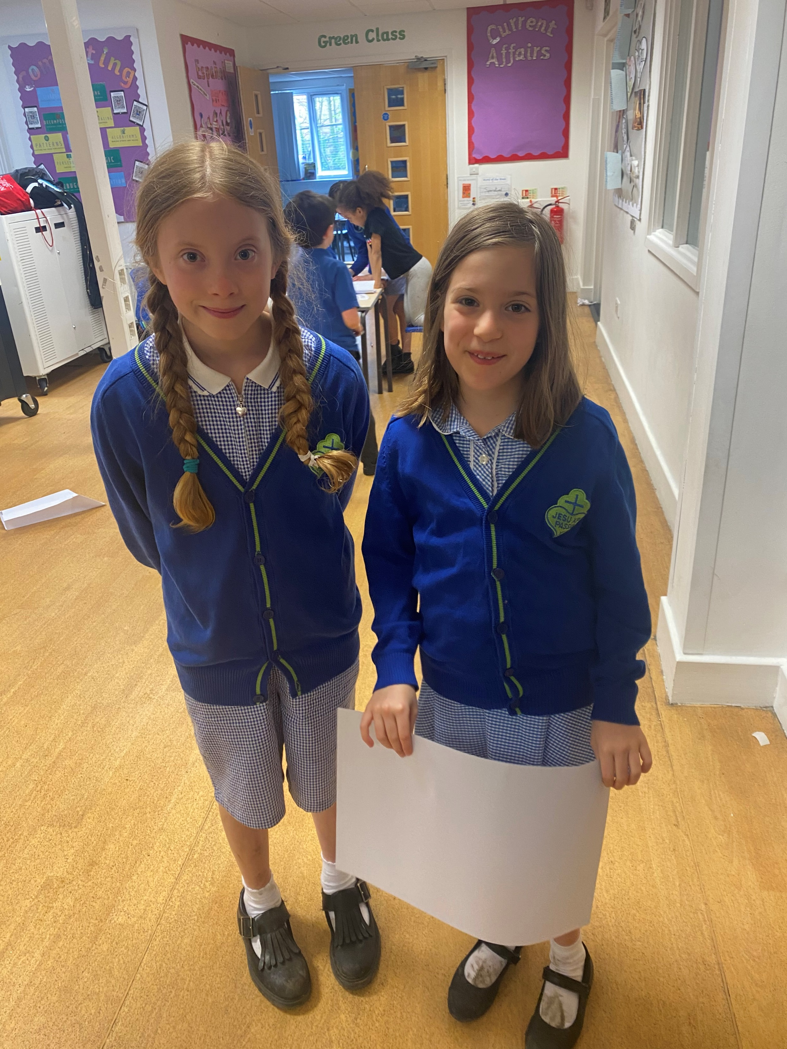
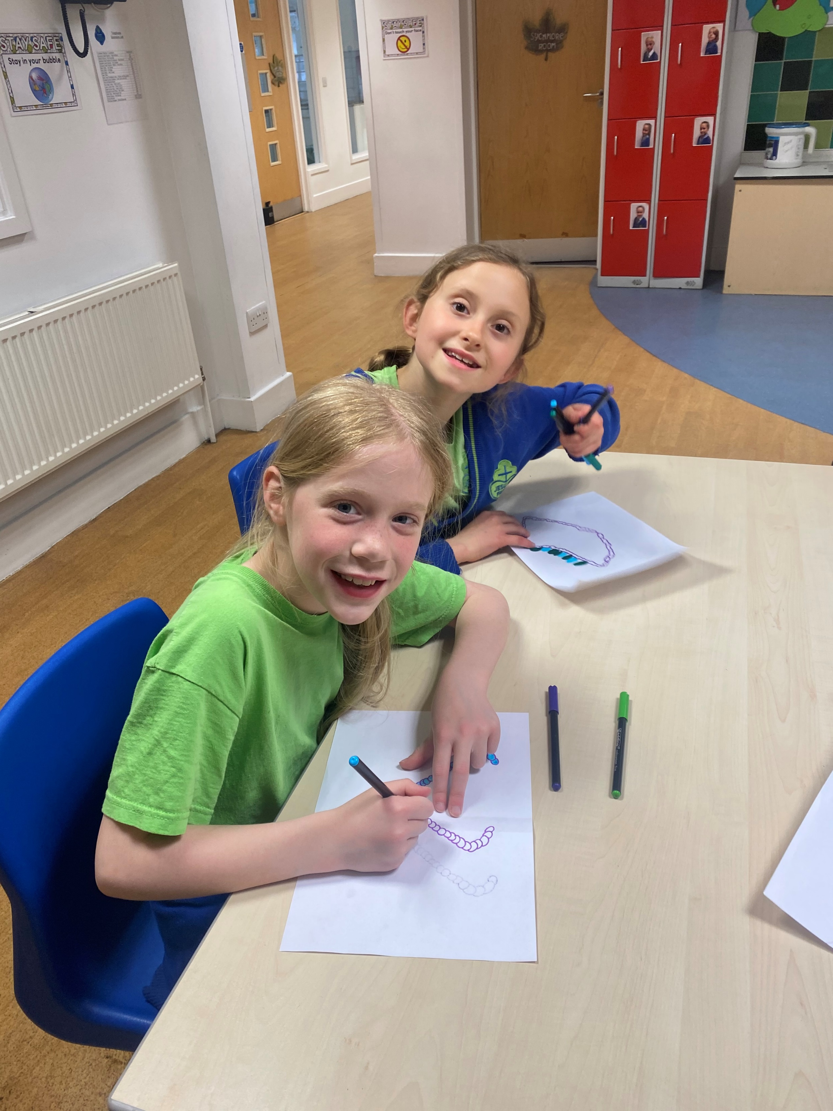

Slide 13
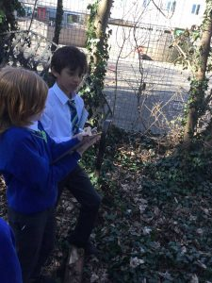
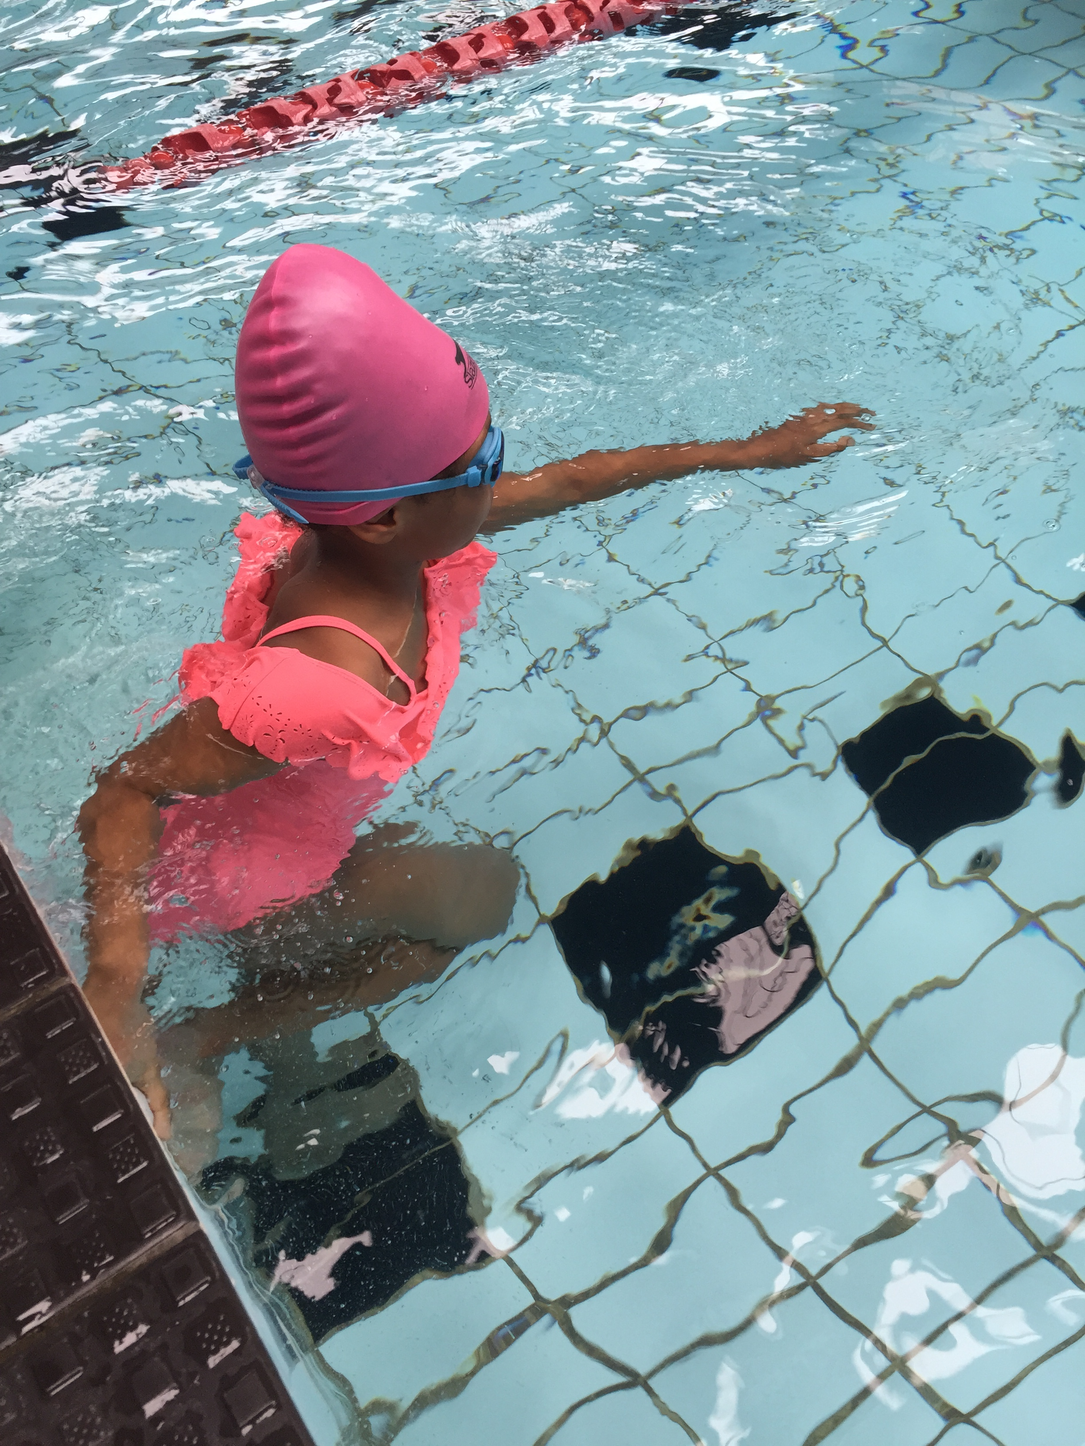
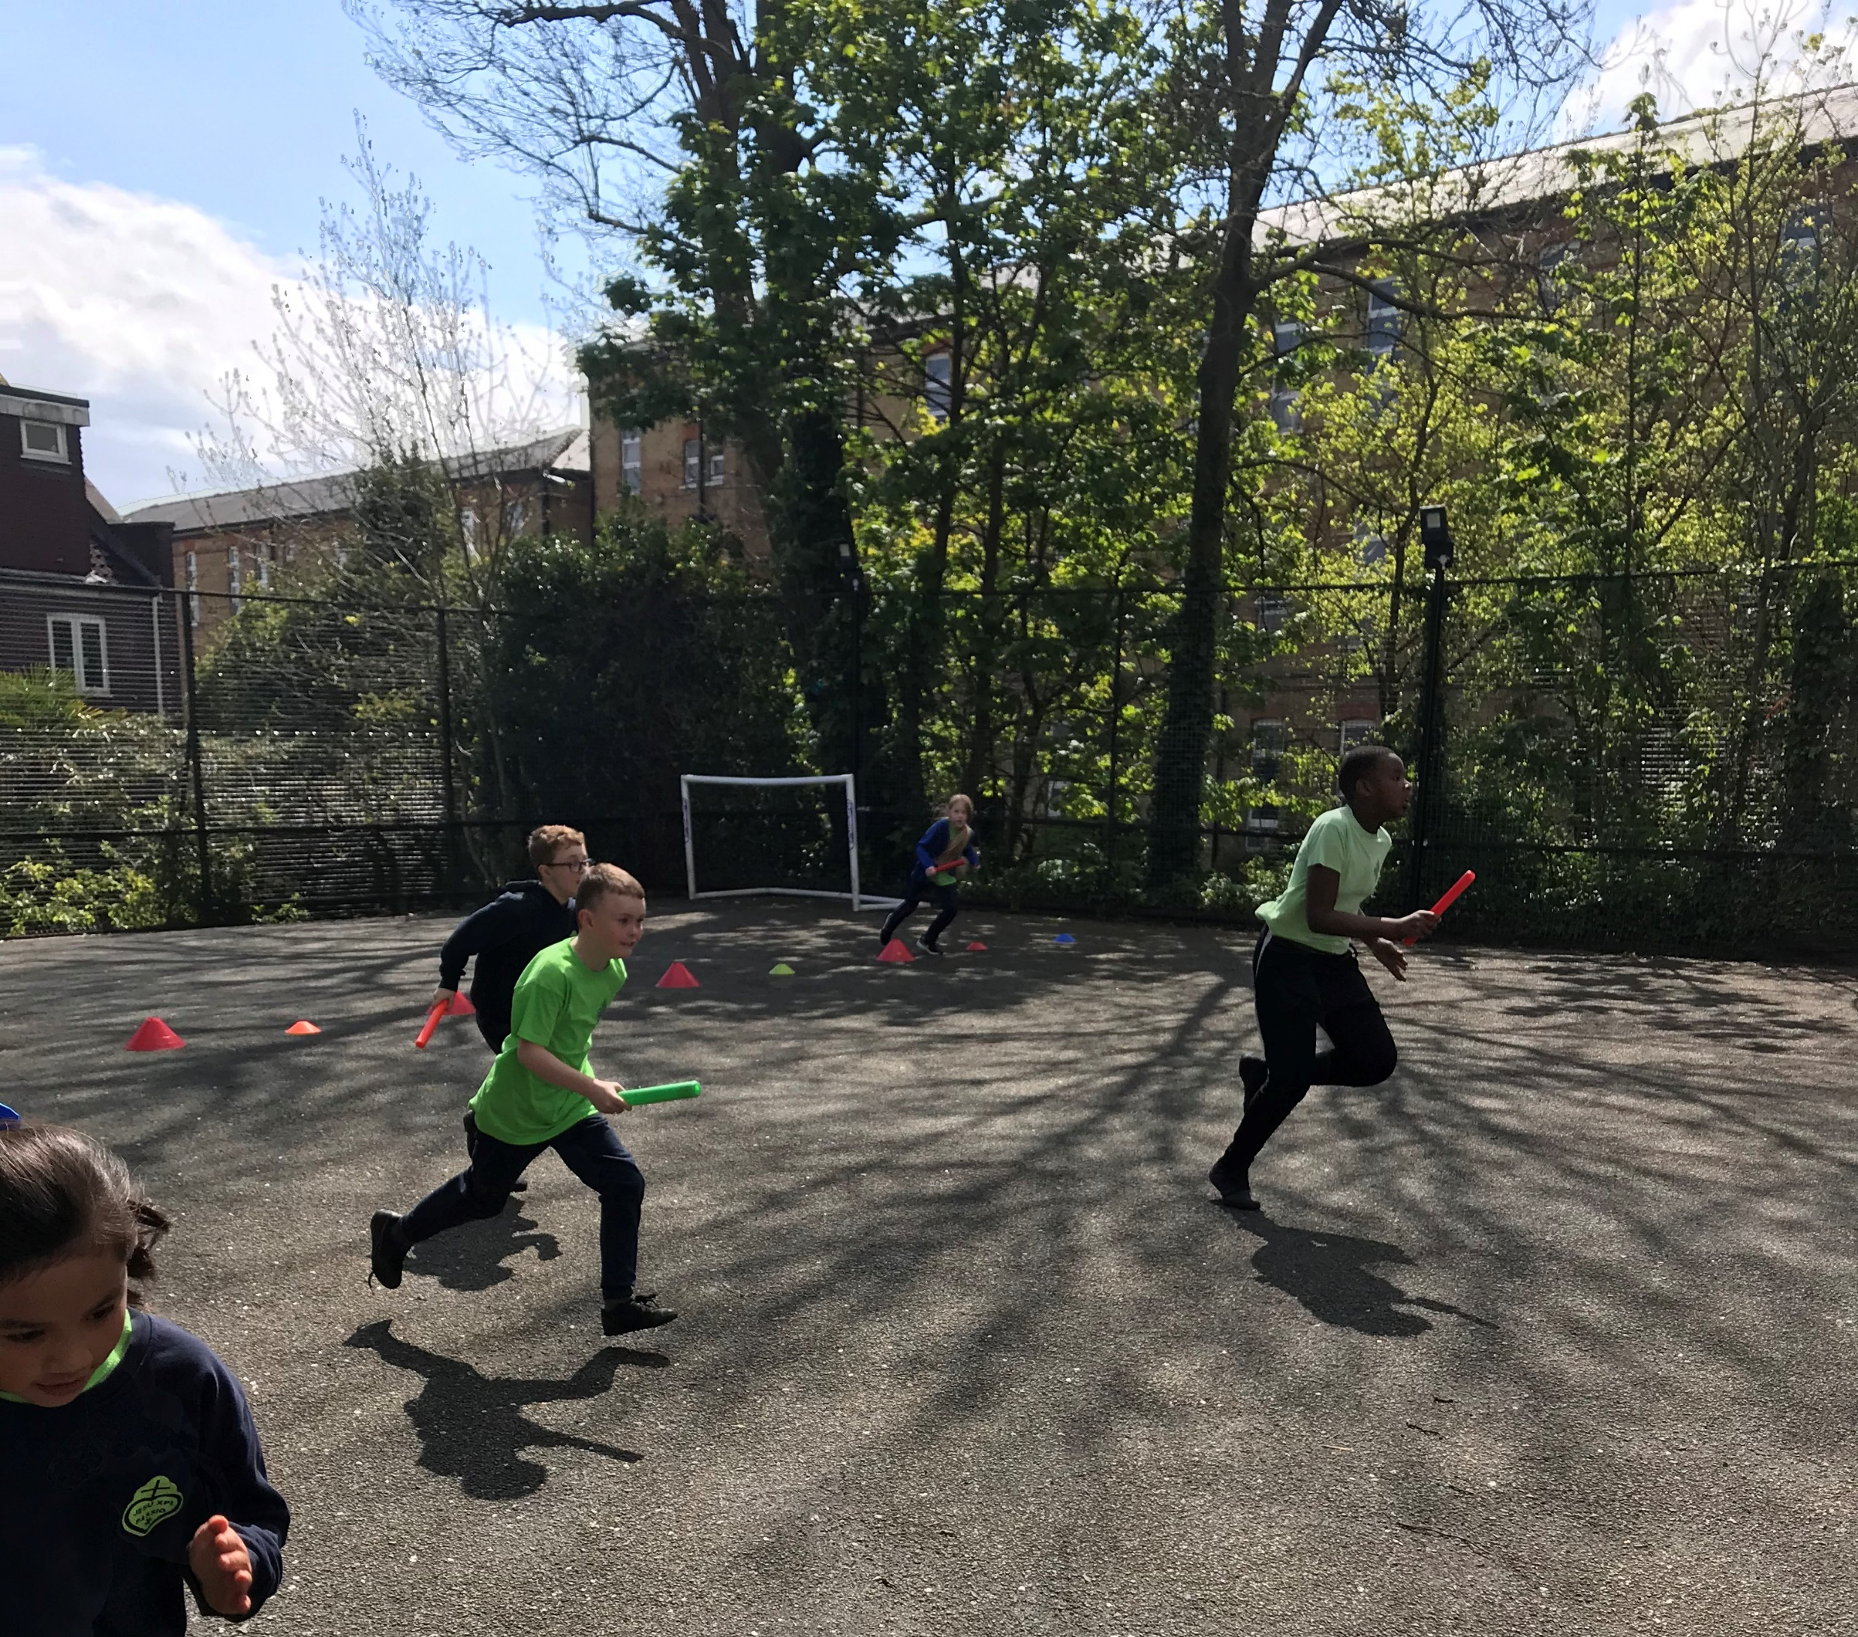
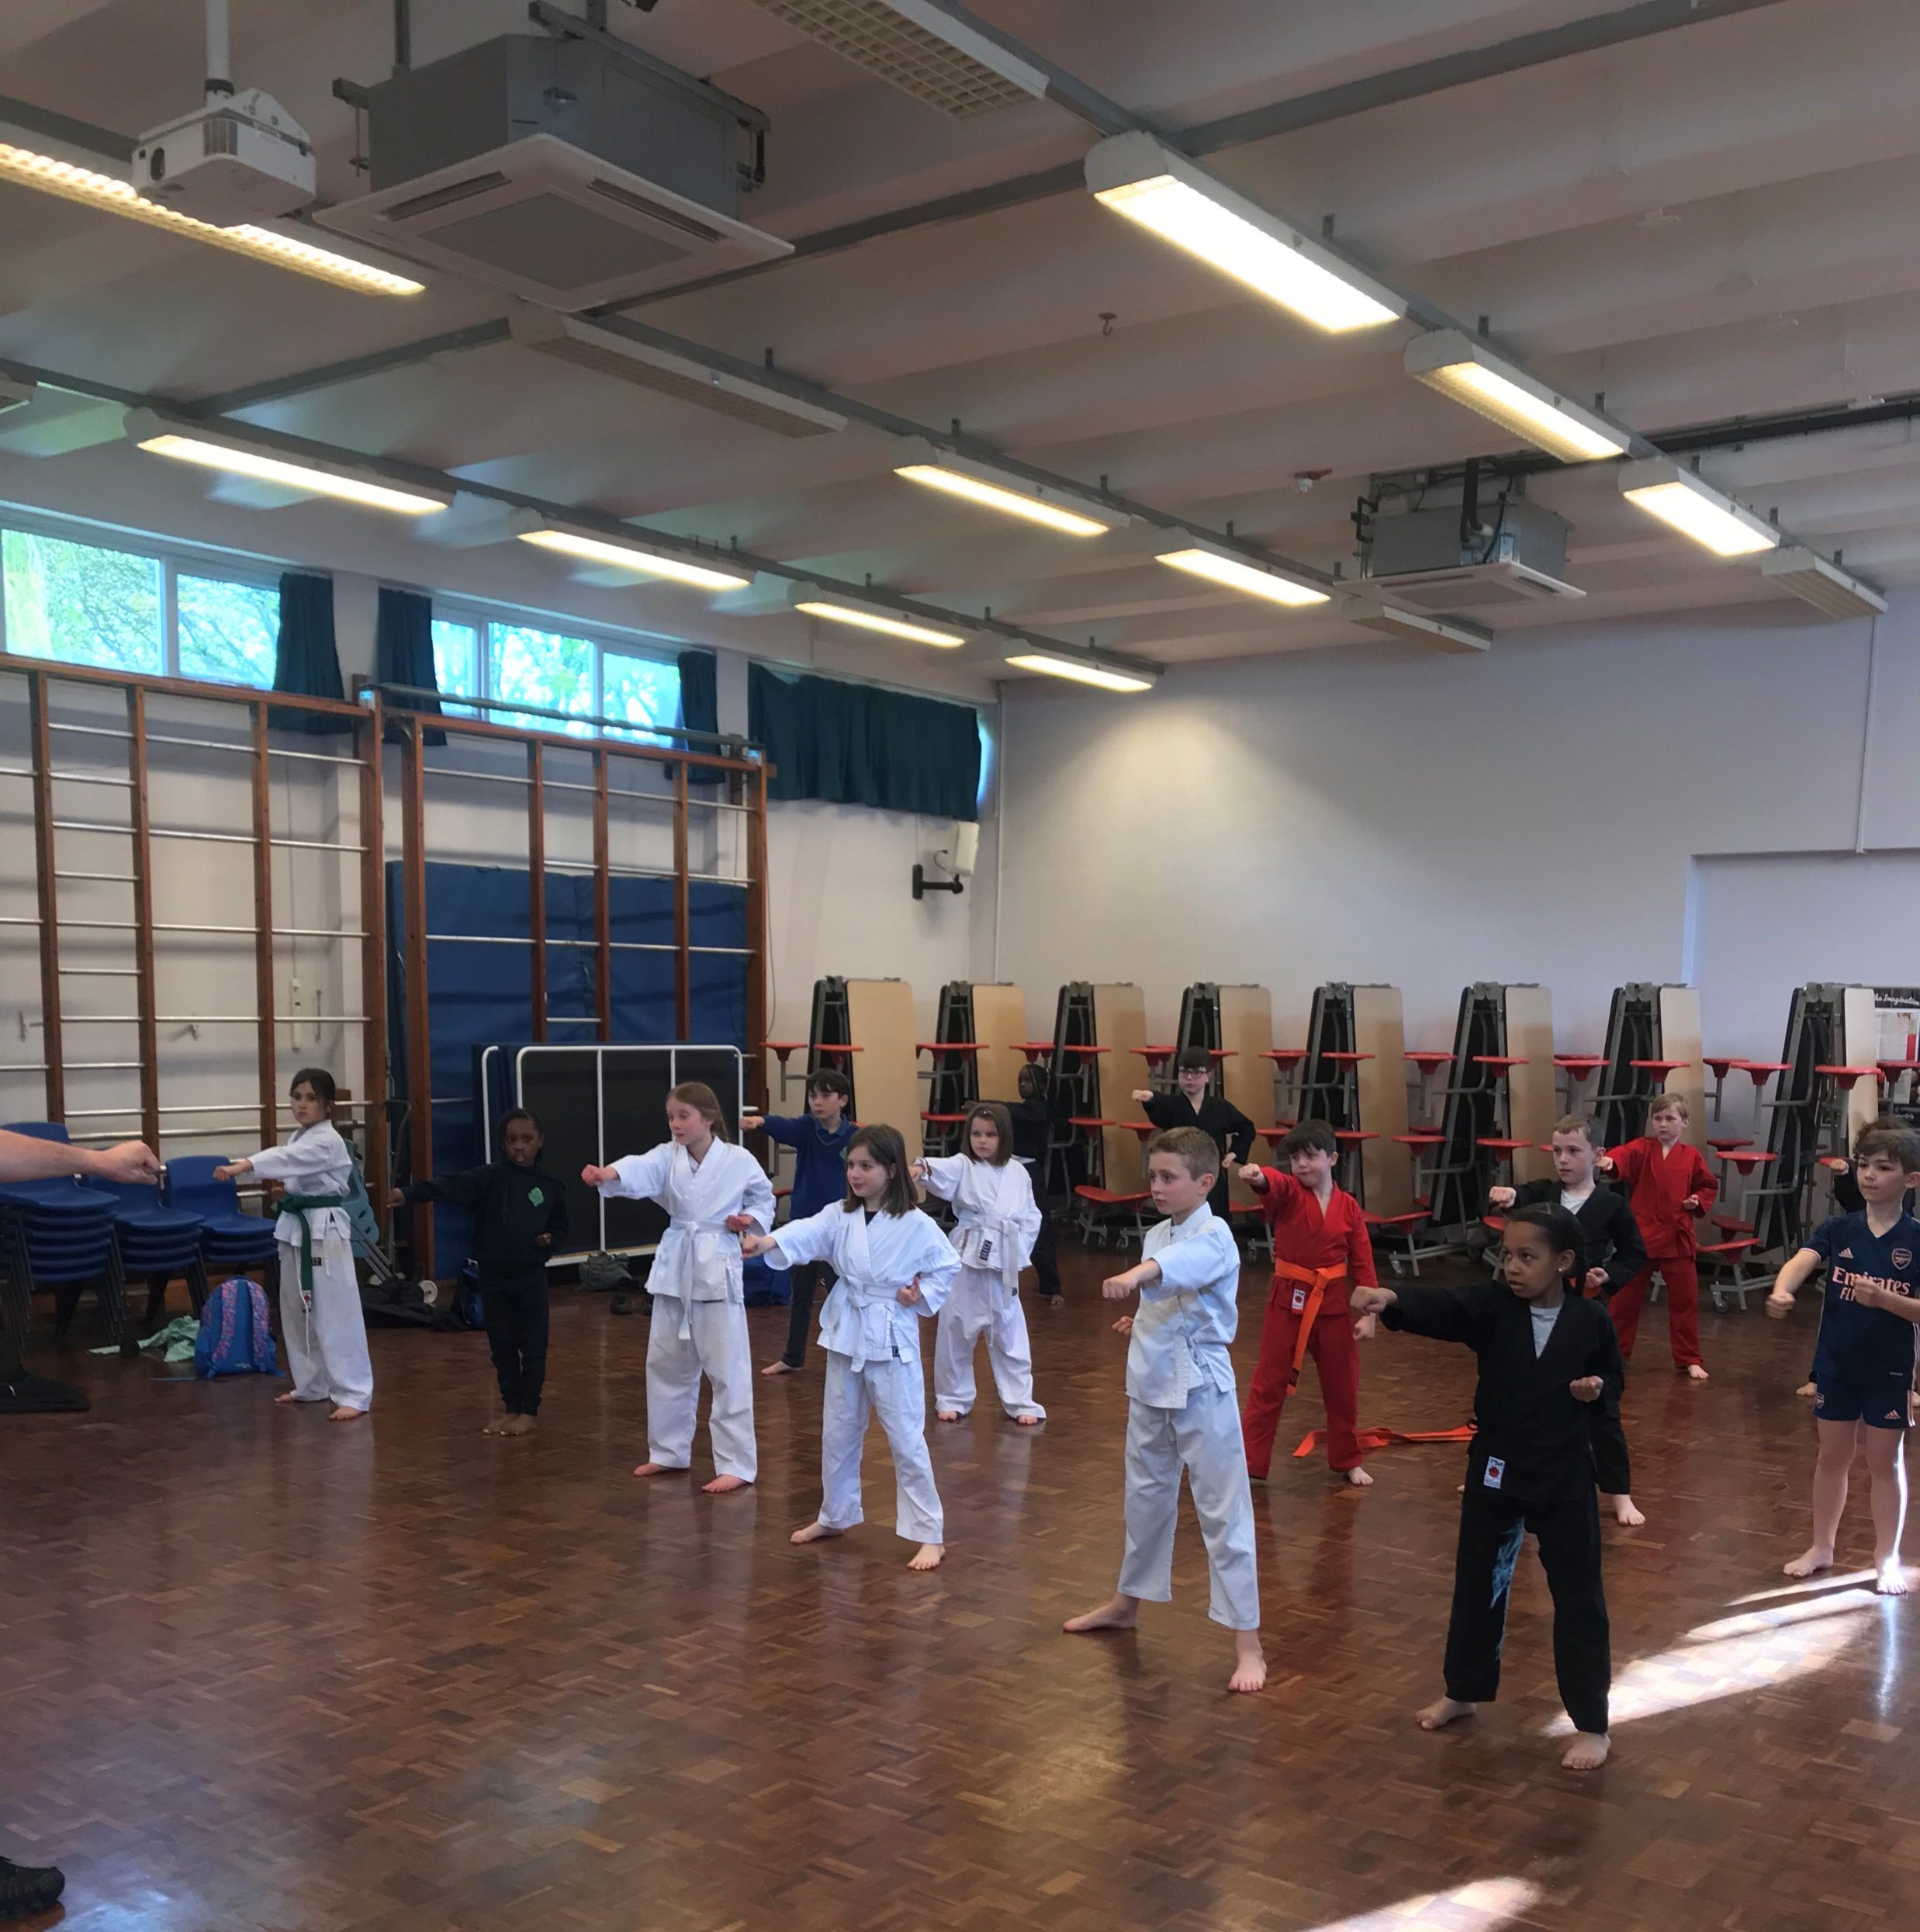

Slide 14
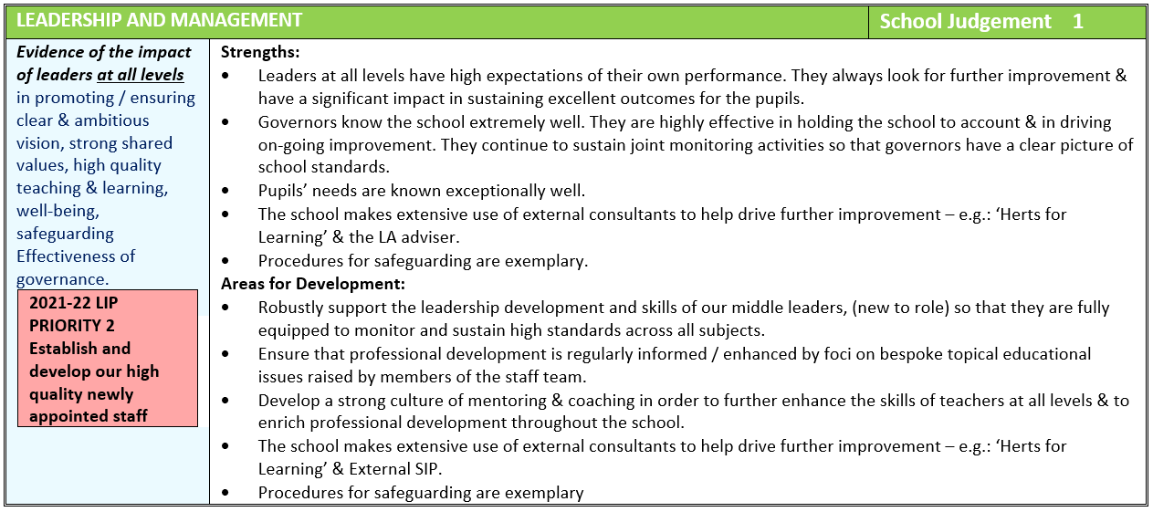

Slide 15
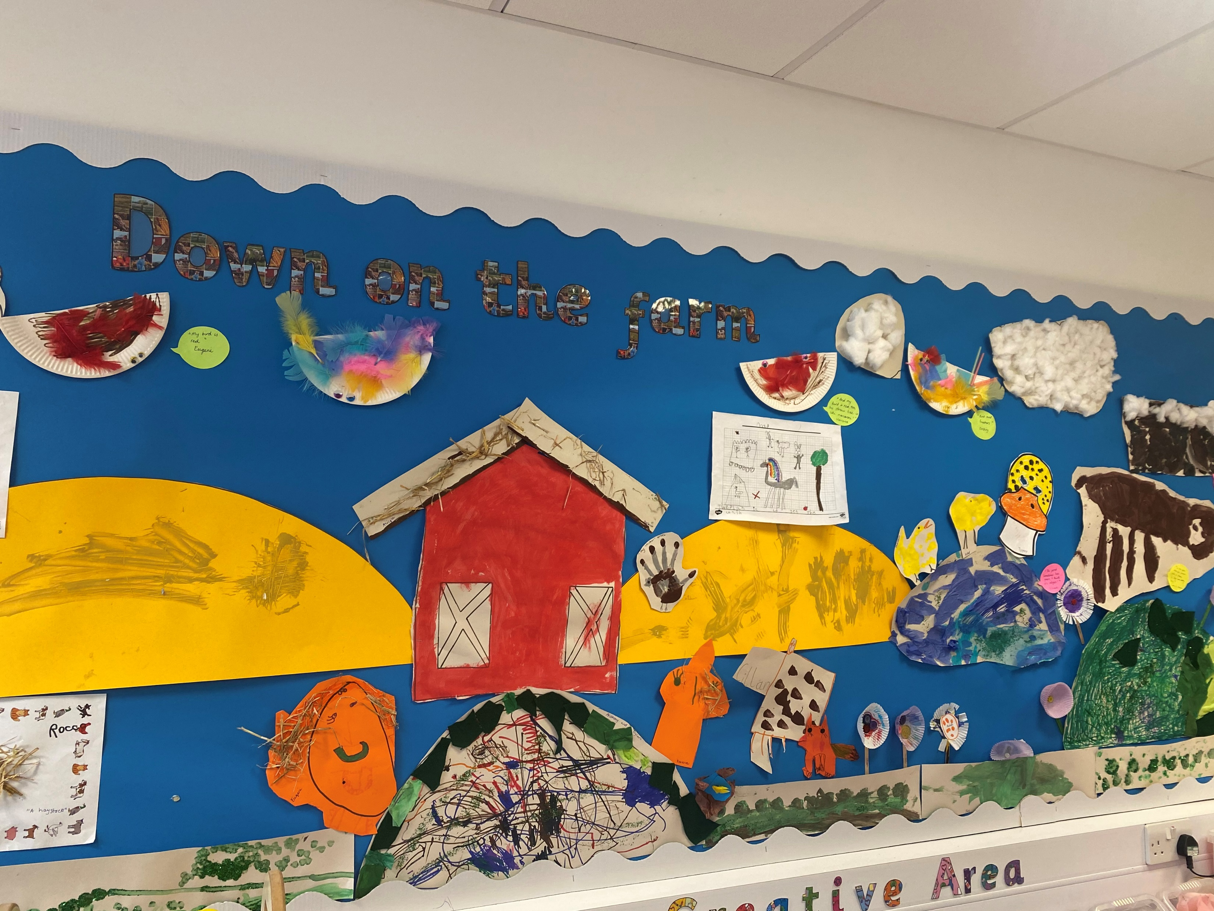
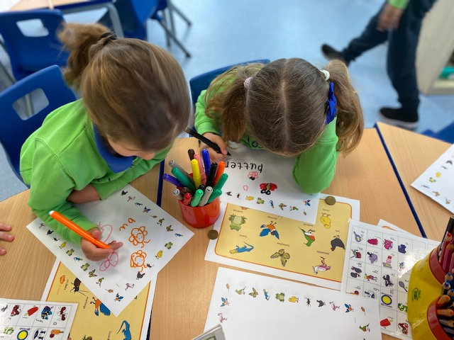
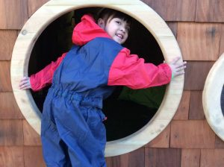
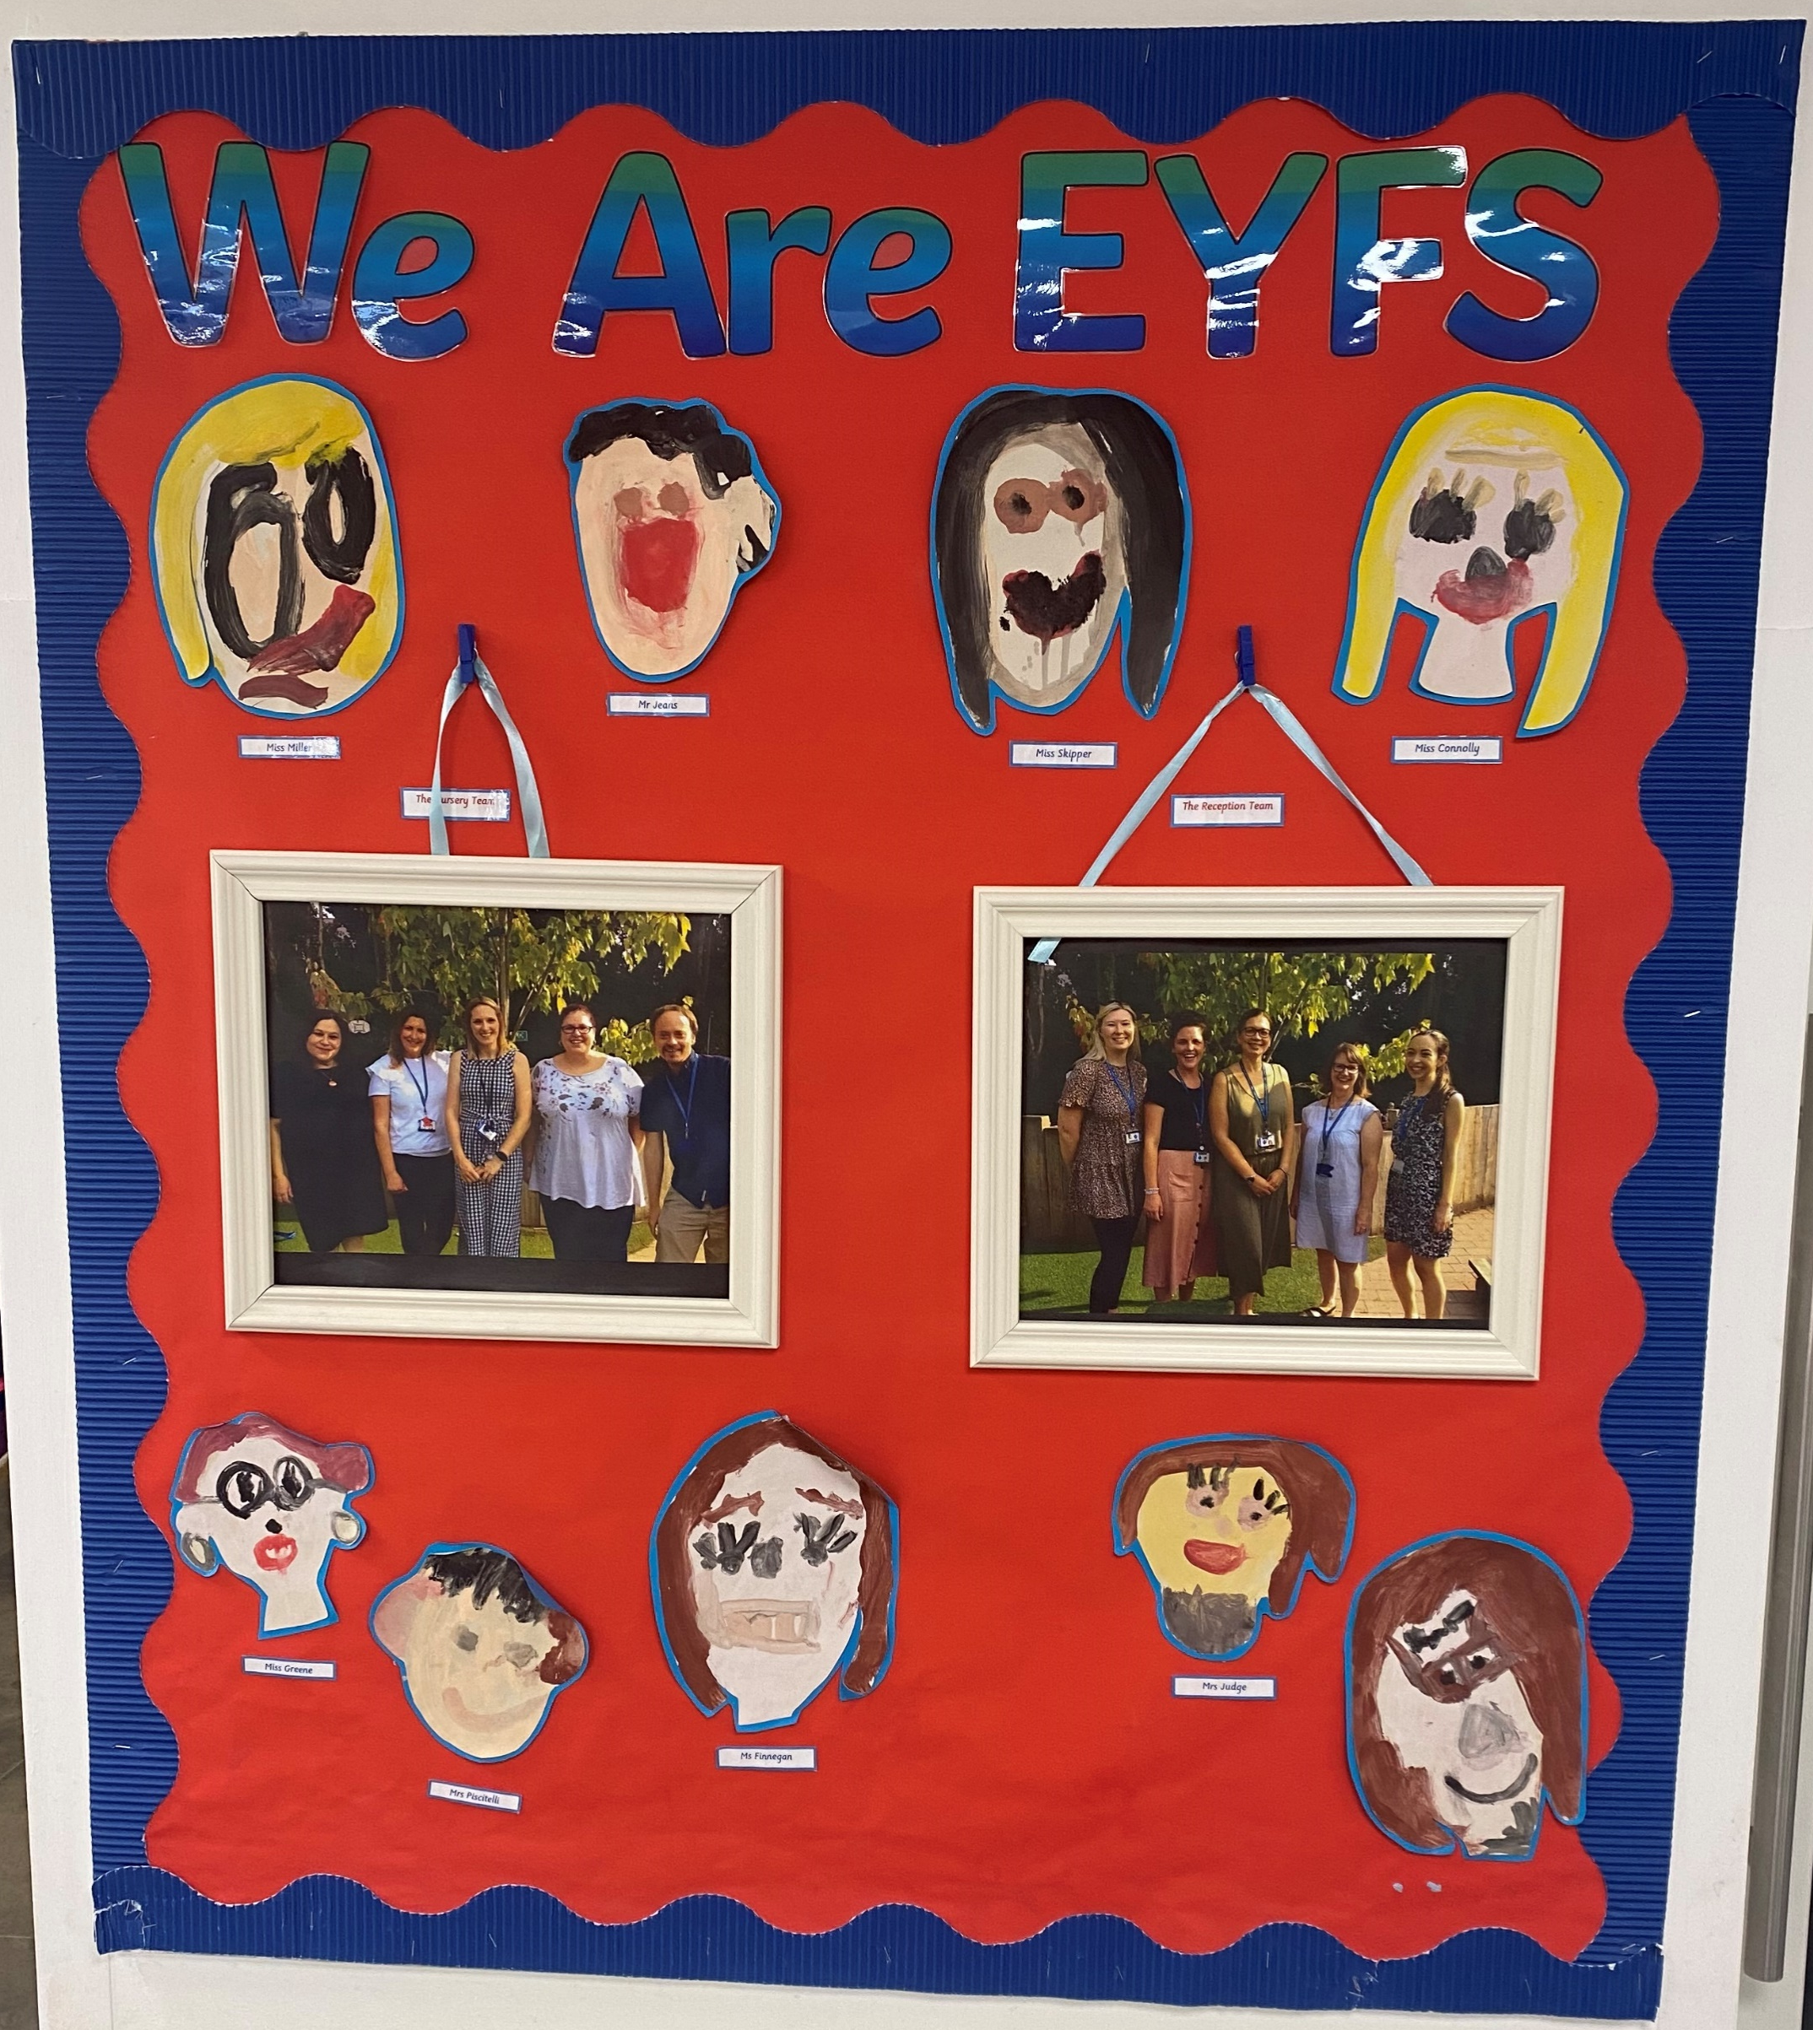
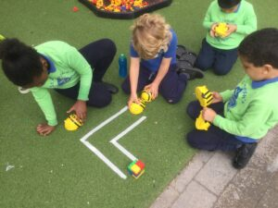

Slide 16
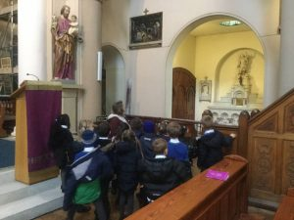
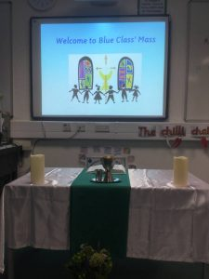
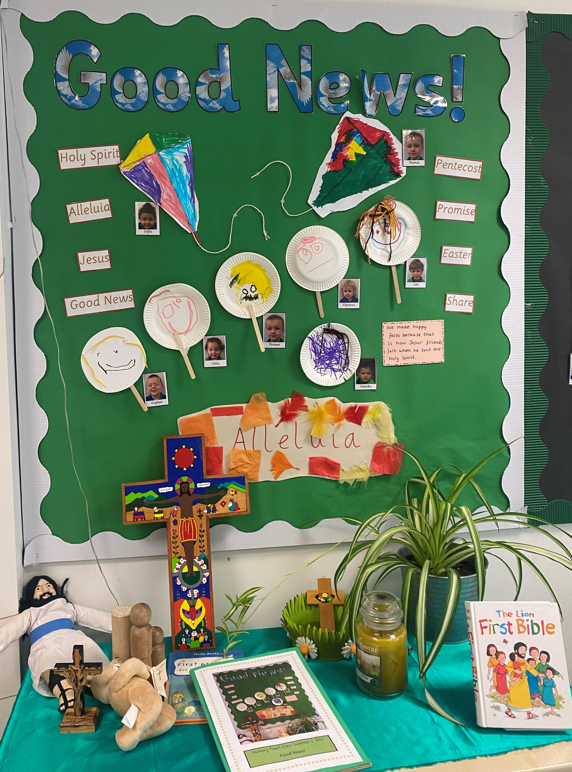
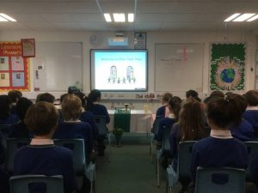
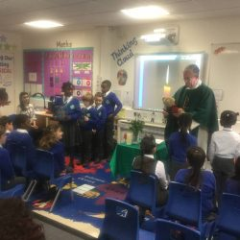

Slide 17
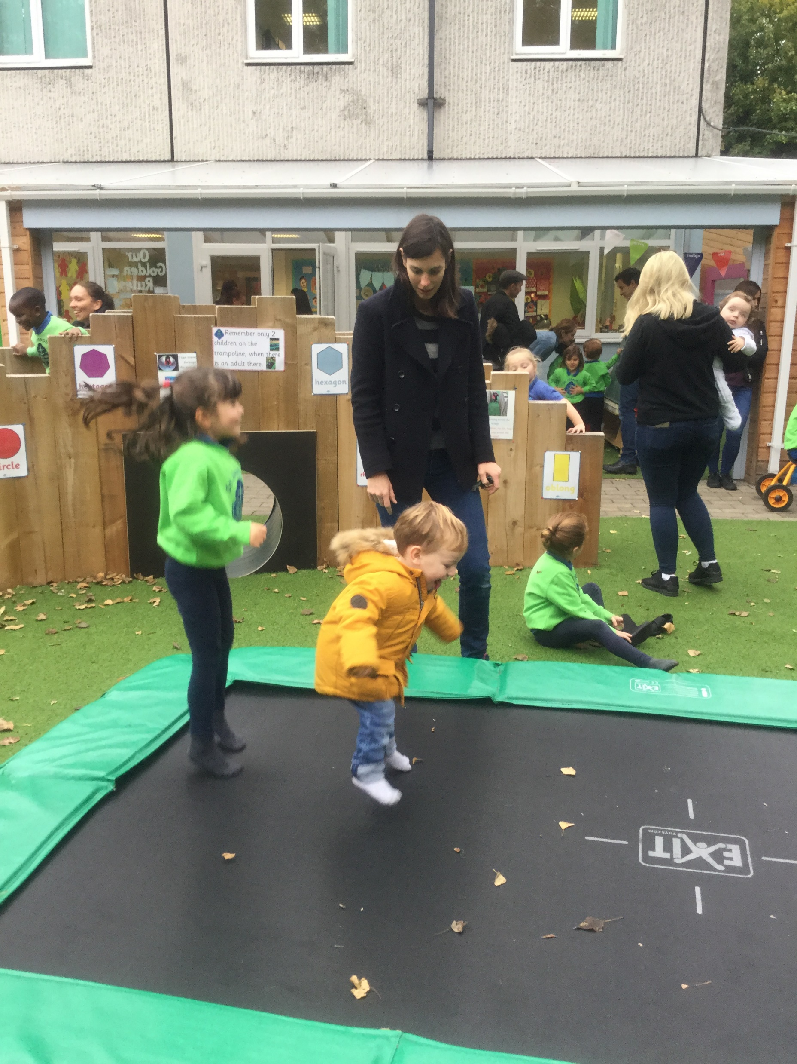
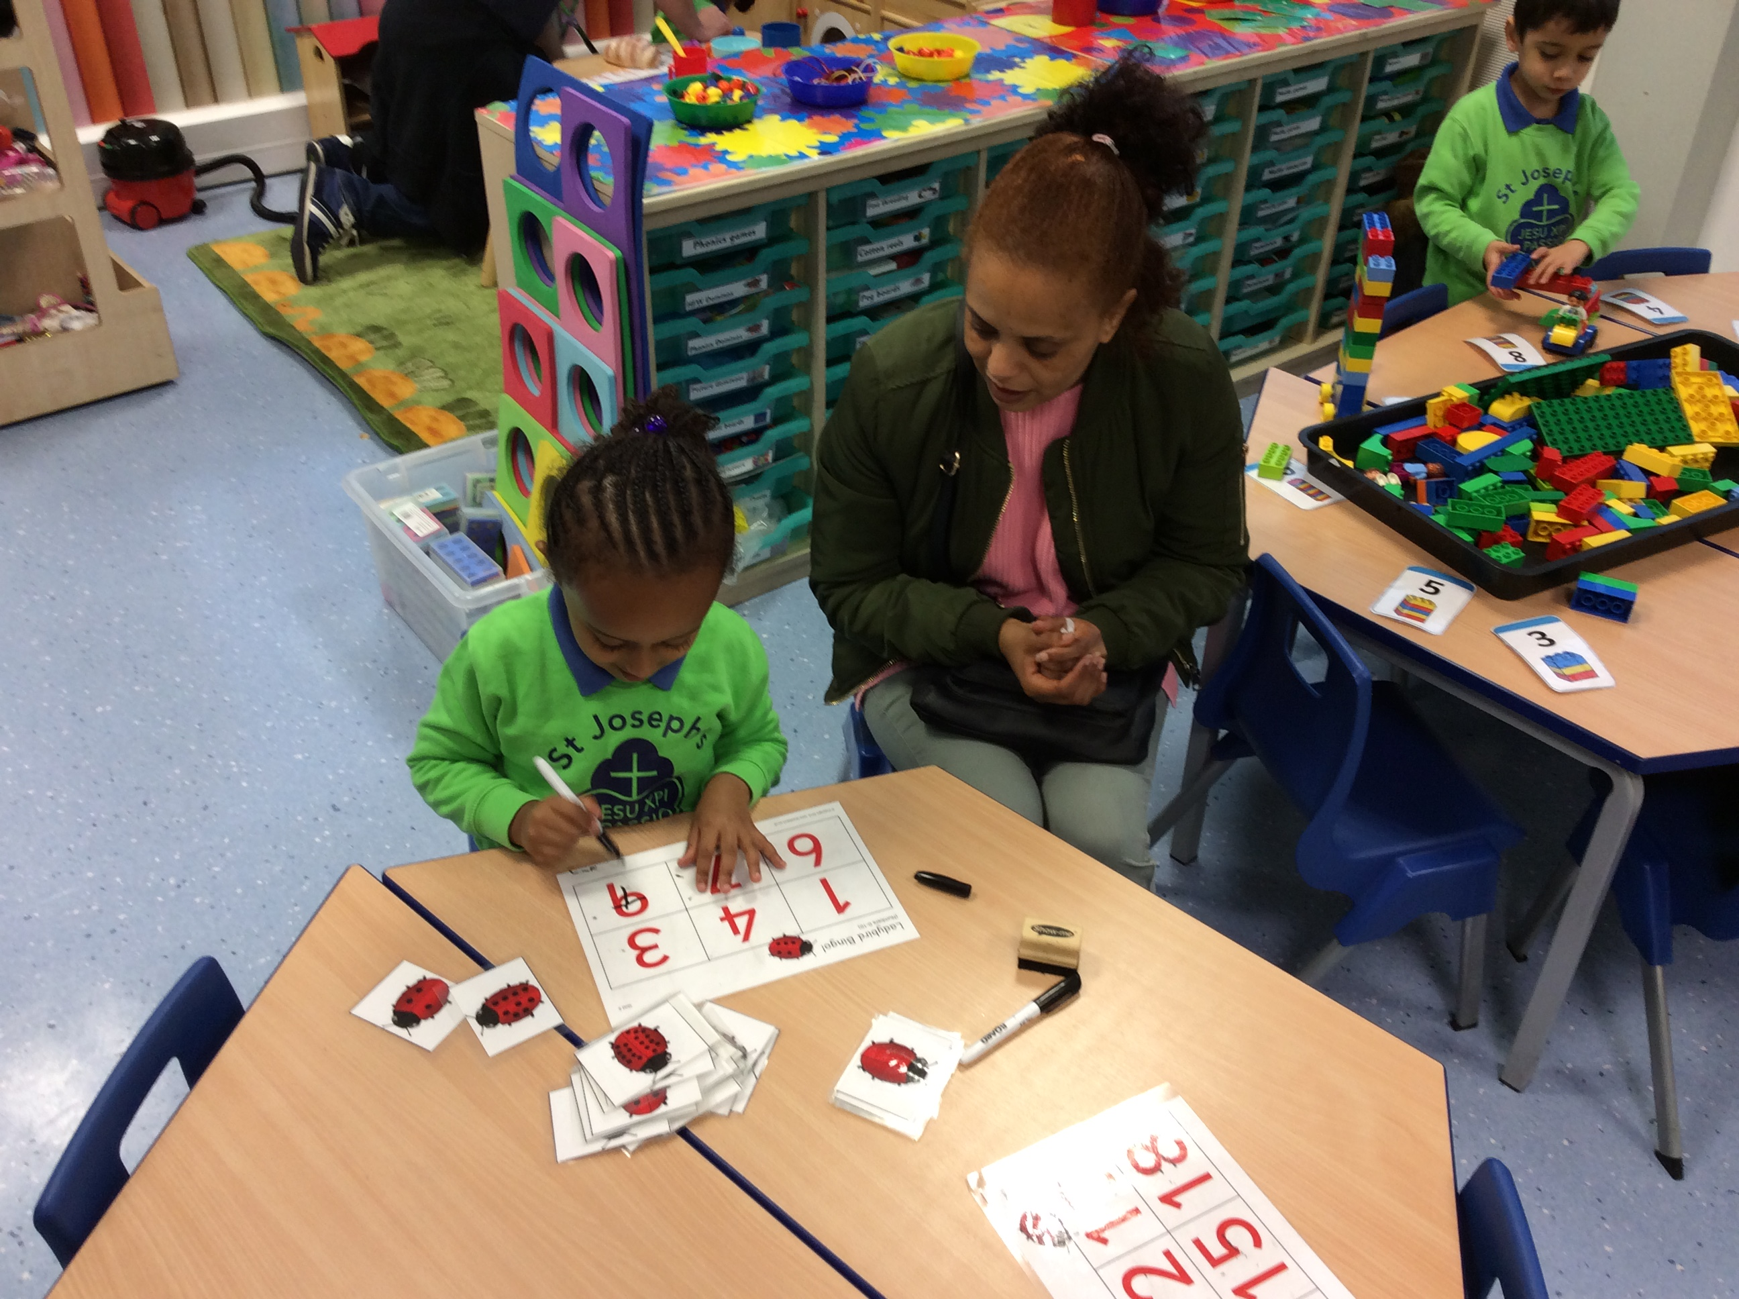
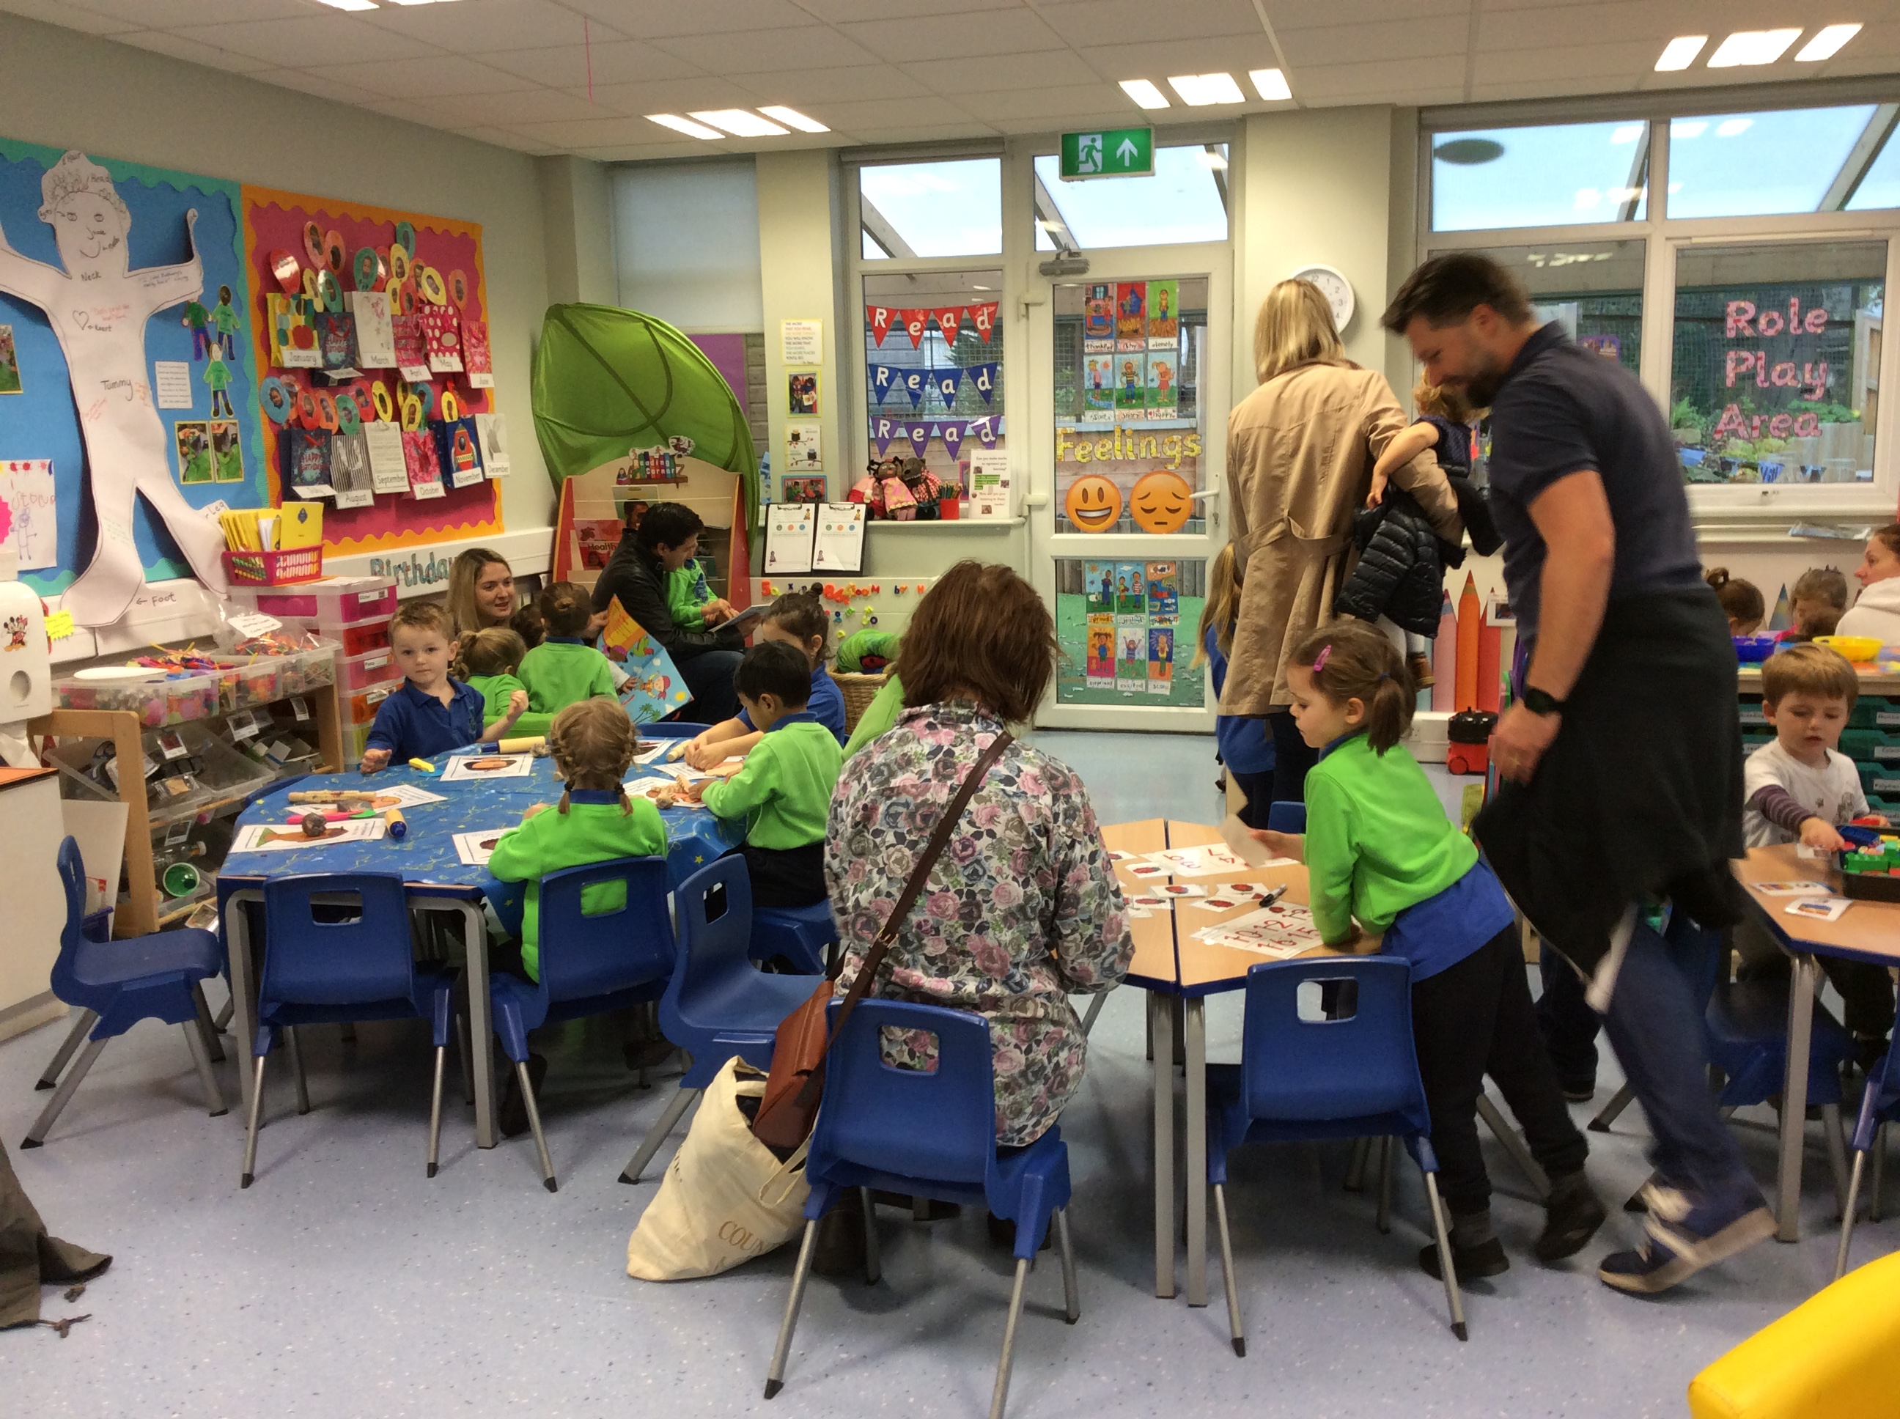
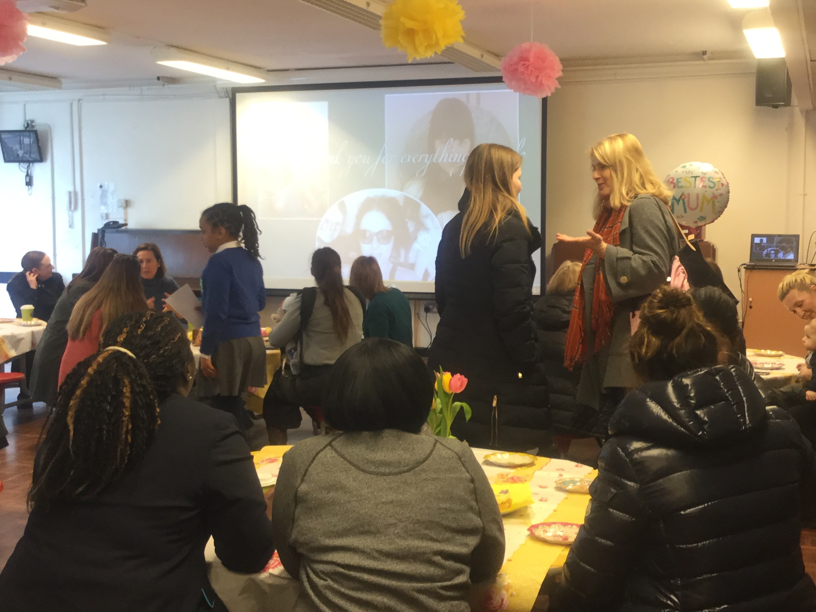

Slide 18
THANK YOU!
Any Questions?

