Slide 1
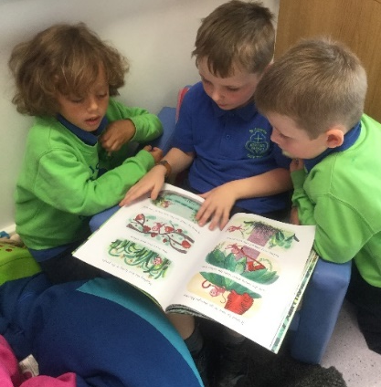
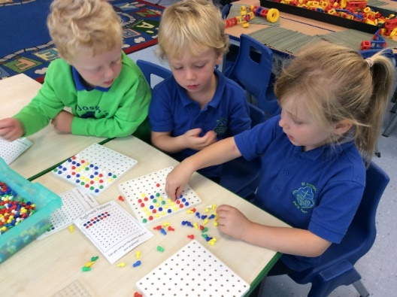
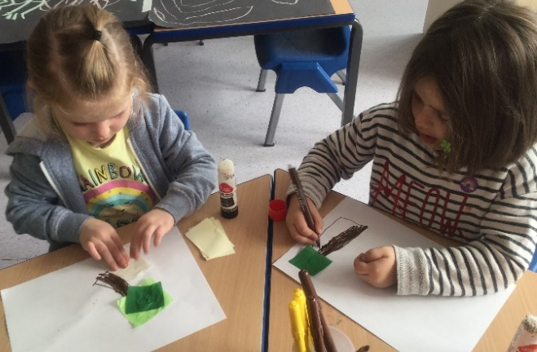
Reception Welcome Meeting
Autumn Term 2019
Thursday 26th September
Notes:
- Reading record
- Home learning book
- star moments
Star of the week teddy and bag
Letter formation rhyme sheet

Slide 2
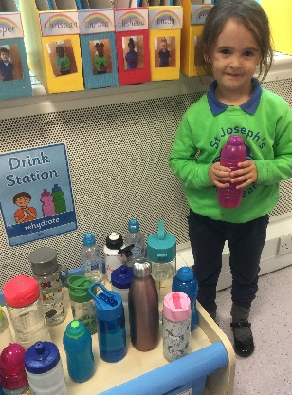
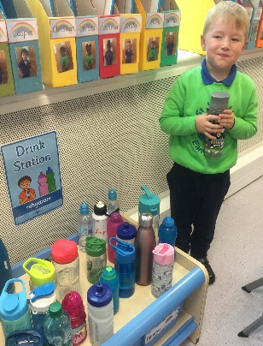
Reception Routines
A great start - Thank you
Entering school
Dismissal
Water bottles – water only please
Packed lunches – healthy eating and no nuts in school
Library Books – changed weekly on Tuesdays (book bag)
PE - Tuesday afternoon
Clothing – please label ALL items
All long hair to be tied back
Small stud earrings
No nail varnish
School shoes
PE - plimsolls
Outdoor – Wellington boots
Medication – Please ensure all medication goes through the office. Do not leave any medication in your child’s book bag.
ALL CHILDREN TO HAVE A PAIR OF PLIMSOLLS AND WELLIES LEFT IN SCHOOL
Birthdays – own clothes and healthy treats (no nuts – we are a NUT FREE school)
Show and Tell (ONE CHILD PER WEEK) Important part of our speaking and listening curriculum
Notes:
PE kits stay in school –Library books will only be changed on Tuesdays.
Snappy goodbyes – children are always fine once you leave.
PE SHOES – children won’t be able to take part if they don’t have them.

Slide 3
Uniform
Lime Green School Sweatshirt with School Logo
Royal Blue Early Years T-Shirt
Navy Tracksuit trousers or navy shorts (Summer)
Grey socks
Black school shoes
Black Velcro plimsolls for PE
Wellington boots
Coat (dark colours including navy, black or dark grey)
PACT folder (book bag)
Please ensure a spare set of uniform is left in your child’s locker at all times in case of any ‘accidents’.

Slide 4
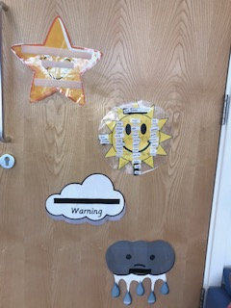
Behaviour Expectations in Reception
Catholic ethos of the school motivates us to create a peaceful and happy environment. Joining in with school prayers
Positive behaviour management strategies
Weather system
Star of the day
Star of the Week Assembly, make a fuss mum and dad!
Bucket filling
Time Out – will inform parents of incident
Open door policy- inform any changes at home etc
Safeguarding – Keeping safe at school
Notes:
Safeguarding is our main focus at St Jo’s. We do a lot of teaching and leaning based on how to keep safe. This includes not talking to strangers outside of school, not leaving the classroom without informing an adult and using the toilets appropriately. Such as 1 child to a cubical, keeping private parts to ourselves and always closing the door. If you would like any advice on this see the nspcc pantosaurus website
We all know children at this age are young and curious about their bodies so please don’t be alarmed if they come home talking about this. If you have any concerns speak to the class teacher.

Slide 5
School Houses
Saint David
Saint Patrick Saint Andrew
Saint George
Notes:
Badges, siblings, house points, house masses, own clothes day, finding out about their house saint

Slide 6
School Houses
Siblings are in the same saint house
Own clothes to represent house colour are worn on house feast day
Sports day – children wear house colour t-shirt with navy shorts
Notes:
A list of houses will be available soon.

Slide 7
SCHOOL TRIPS
Parent Pay
One trip per term
Parent volunteers will need to complete a volunteer form from the office.
Trip letter will be sent out in coming weeks
Notes:
Library books will only be changed on a Tuesday
Parents will be selected at random out of a hat

Slide 8
Getting Involved
Stay and read- Monday morning, 8:40 - 8:55am
Stay and play sessions (every Friday 8.40am – 9.10am)
Star Moments (see hand out)
Star of the week – bear and diary
Focus Child Sheet
TAPESTRY – online learning journal
Parent workshops Autumn/Spring term – Phonics / Maths lessons (Dates TBC)
Just a quick note: Name writing please NO CAPITAL letters except for the first letter of their name – Thank you

Slide 9
Home Learning
Home learning will be handed out every Friday and is due back in on the following Wednesday.
Activities will link to what the children have been learning.
Home reading – Every day
Research shows that reading is the single most important thing you can do to help your child's education. It's best to read little and often, so try to put aside some time for it every day.
Notes:
Home learning – can be more play based and outdoor/mark making and creative.
Home reading - every day – please ensure your child brings in their reading book every day
Please write in the reading record every time your child reads.
They will receive a new book once a week.

Slide 10
School Website
http://www.st-josephs.islington.sch.uk/
Check our weekly blog for reception news, photos and updates!
Curriculum information

Slide 11
Dates for your Diary
Welcome Liturgy:
Tuesday 8th October, 9.30
Parents Evening:
Thursday, 18th October 1pm – 7pm (school closes 1pm)
Phonics Workshop – TBC
School Trip to The living Nativity
Tuesday 3rd December
Reception Christmas Nativity
Friday 13th December
Thank you!
Any questions?

